Slide 1



Language and the Brain: Deep Learning for Brain Encoding and Decoding
Subba Reddy Oota¹, Manish Gupta^{2,3}, Raju S. Bapi²
¹Inria Bordeaux, France; ²IIIT Hyderabad, India; ³Microsoft, India
subba-reddy.oota@inria.fr, gmanish@microsoft.com, raju.bapi@iiit.ac.in

Slide 2
Agenda
Introduction to Brain encoding and decoding [10 min]
Text Stimulus Representations [30 min]
Deep Learning for Brain Encoding [40 min]
Deep Learning for Brain Decoding [30 min]
Summary and Future Trends [10 min]

Slide 3
LMs are trained to predict missing words
jumps
Language model
The
quick
brown
fox
[MASK]
Notes:
These language models are trained to [Keep clicking]
predict missing words over millions of text documents.

Slide 4
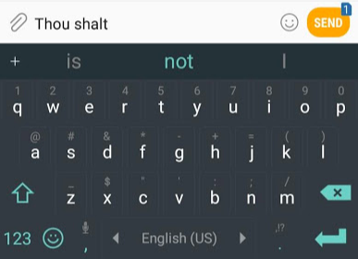
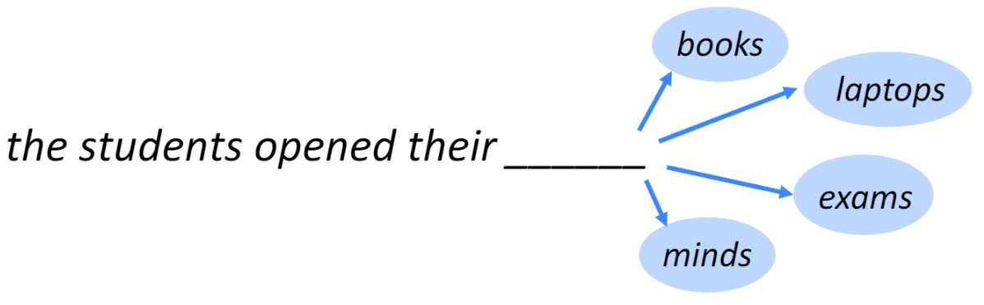
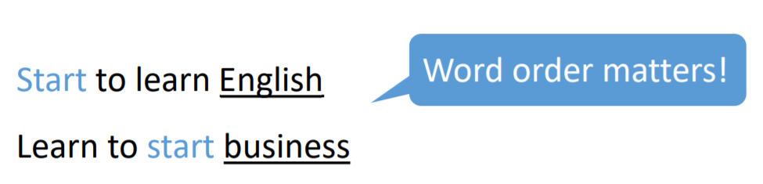
Background
Language Model?
Task of predicting what word comes next
Notes:
What a language model is – basically a machine learning model that is able to look at part of a sentence and predict the next word.
The most famous language models are smartphone keyboards that suggest the next word based on what you’ve currently typed.
Have you noticed the ‘Smart Compose’ feature in Gmail that gives auto-suggestions to complete sentences while writing an email?

Slide 5
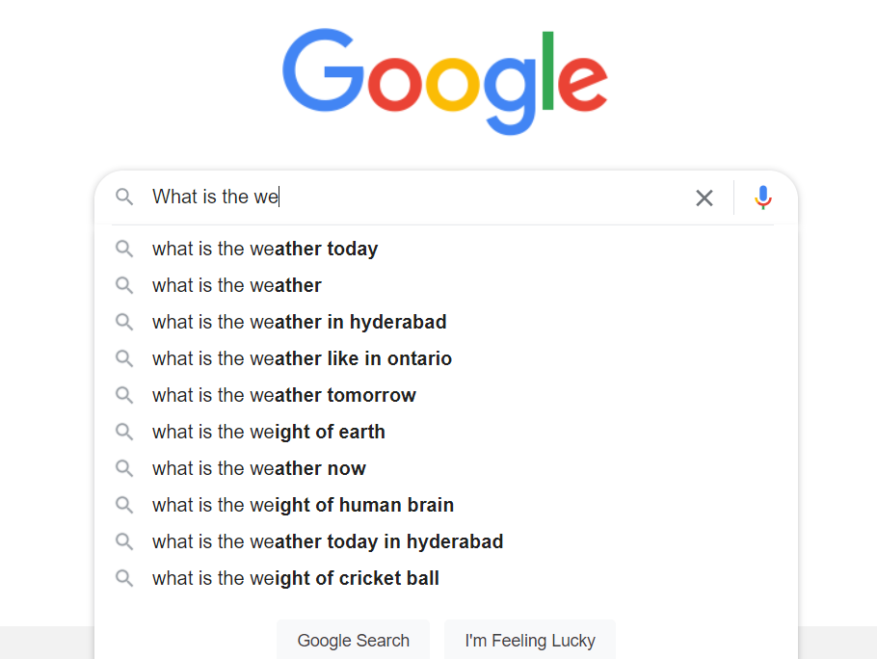
You use Language Models every day!

Slide 6
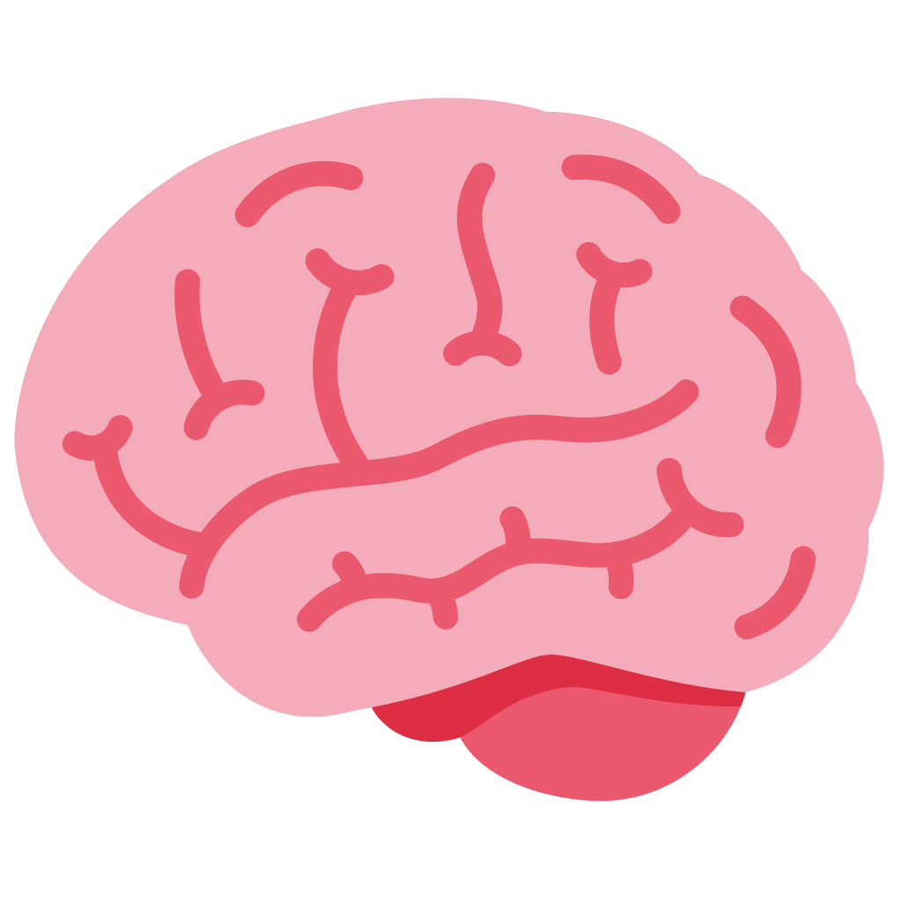
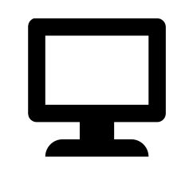
But… LMs may be learning shallow heuristics to solve tasks
I put the heavy table on the book and it broke.
What broke?
“the book”
“the table”
[Trichelair et al.]
Notes:
However, researchers have shown that these language models may merely be learning shallow heuristics to solve tasks.
I’ll illustrate one challenge that language models face, using an example.
[CLICK] If I ask you the question “what broke?” and I gave you two choices: “the book” or “the table”,
[CLICK]
Without any other information, most people will choose “the table”.
[CLICK]
Now, if I provide additional context “I put the heavy table on the book and *it* broke.”
[CLICK]
Most of us would switch our answer to “the book”.
What would a language model choose?
[CLICK]
It turns out that a language model would say that the table is the one that broke in both cases.
Because it presumably has learned that tables and breaking appear together in context more frequently than books and breaking.

Slide 7
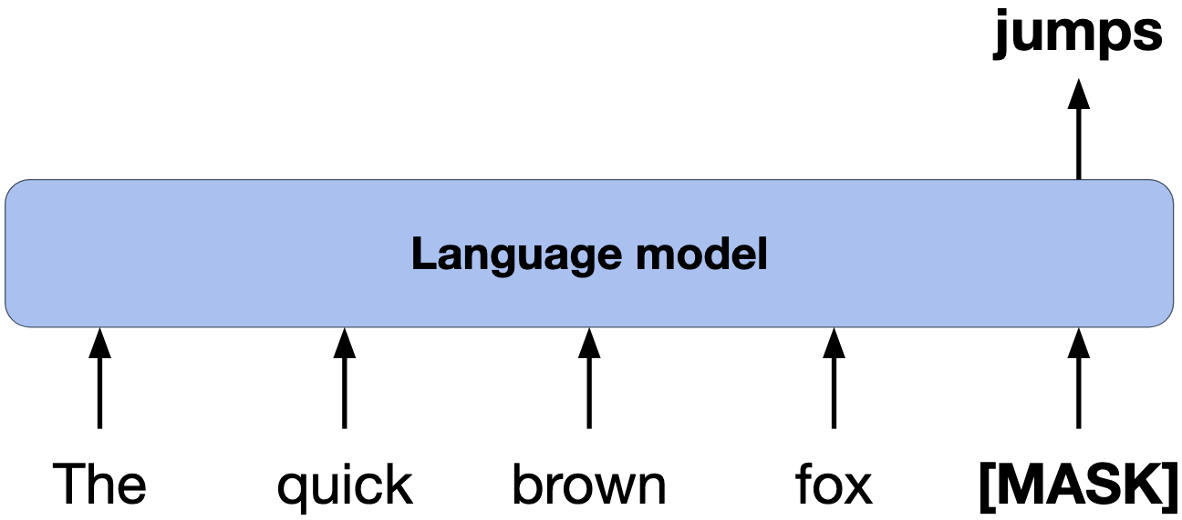
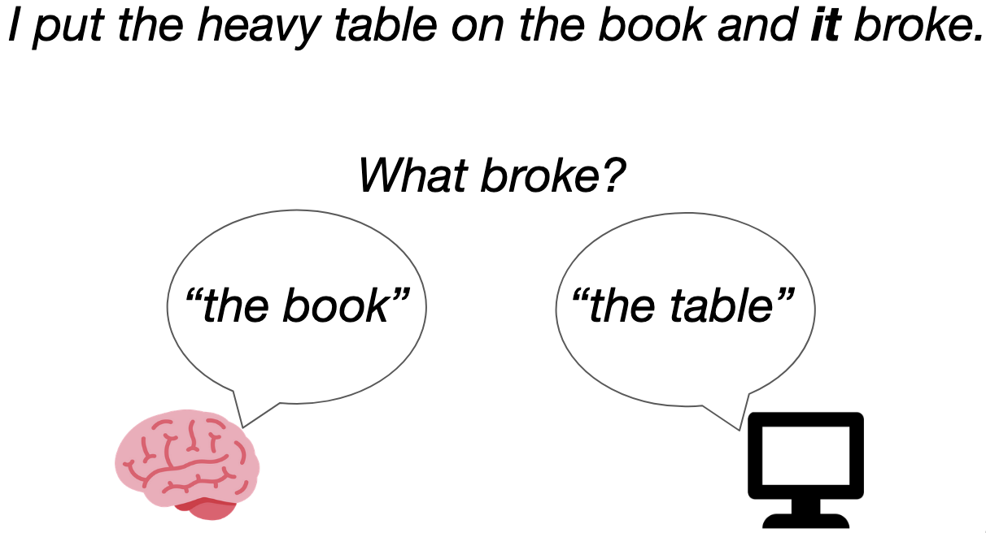
Lots of progress made, but still a long way to go
Lots of progress
Still a long way to go
How do we build systems with a deeper understanding of language?
Notes:
Lots of progress has been made to improve the understanding capabilities of Language models.
However, there is clearly still a long way to go.
[CLICK]
So, How do we build systems with a deeper understanding of language?

Slide 8
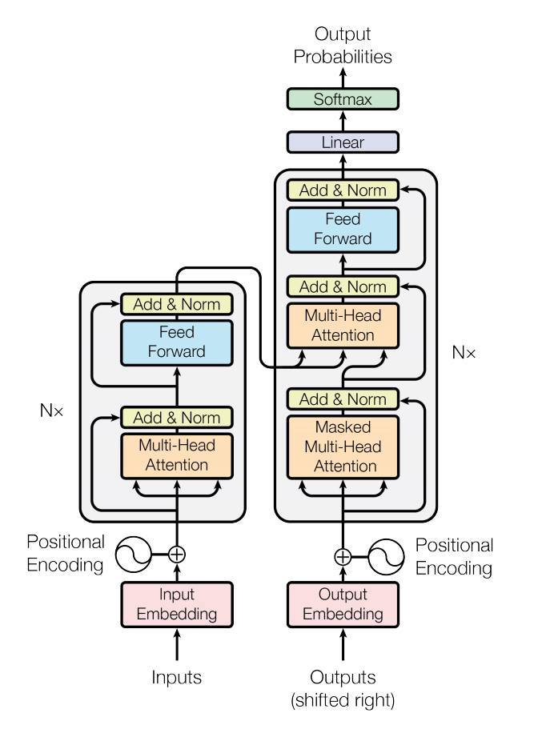
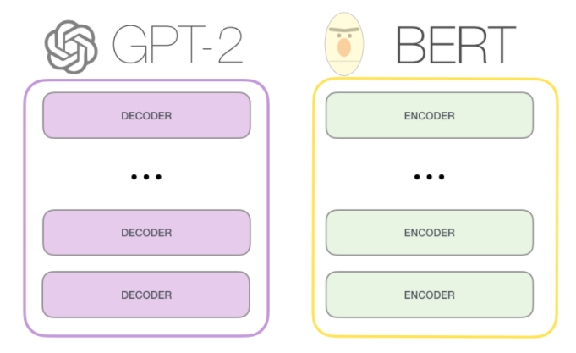
Transformer
Harry never thought he would
Harry never thought he ???
Ashish Vaswani, Noam Shazeer. "Attention Is All You Need." NeurIPS (2017).

Slide 9
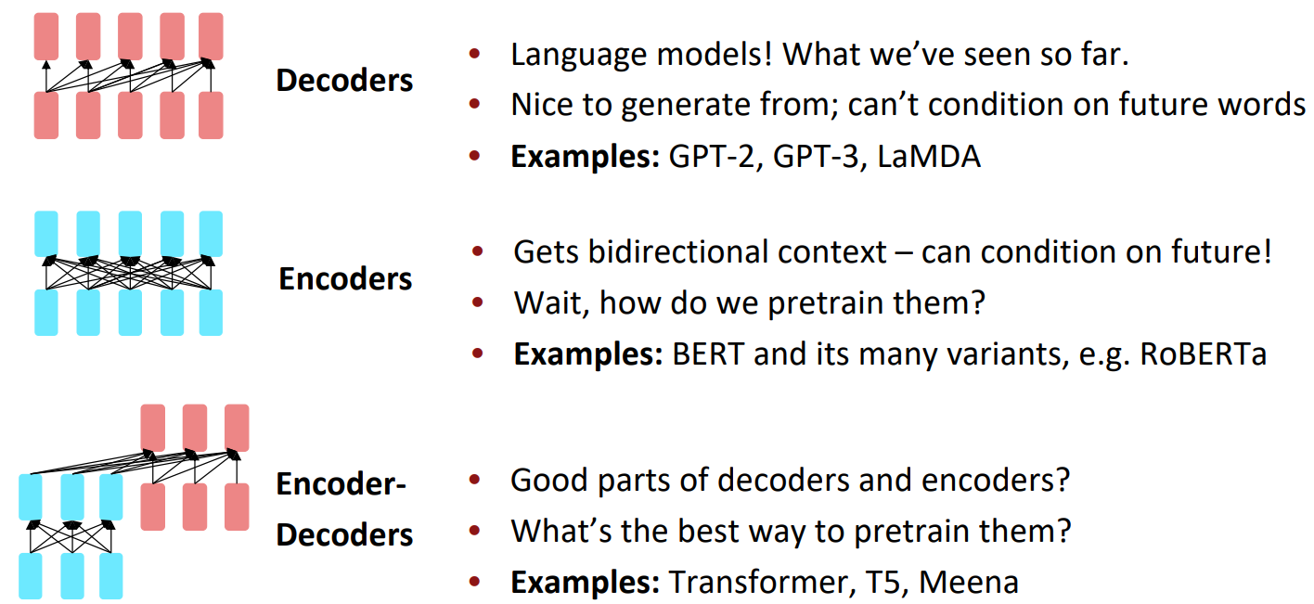
LLMs: Pretraining for three types of architectures

Slide 10
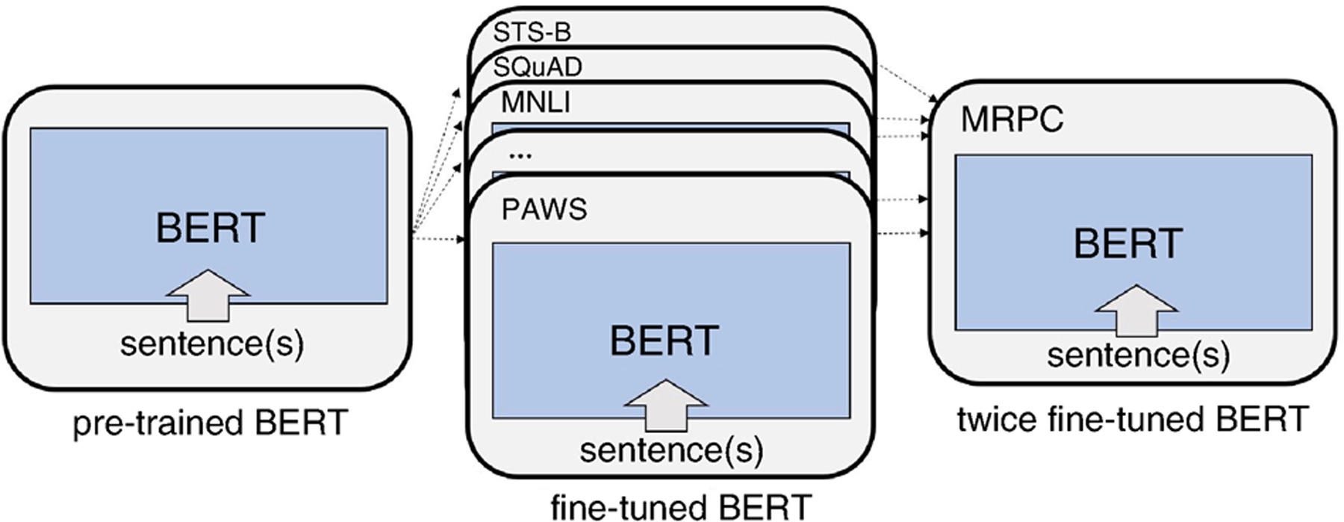
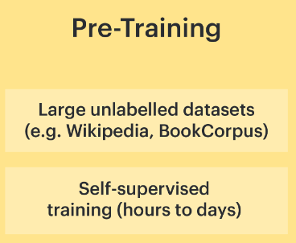
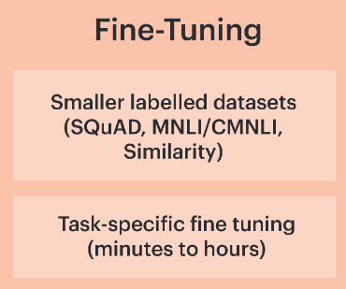
Task-specific language models
Jacob Devlin, Ming-Wei Chang, Kenton Lee, Kristina Toutanova. "BERT: Pre-training of Deep Bidirectional Transformers for Language Understanding" NAACL (2018).
Notes:
In this study, we investigate the correlation between brain activation and feature representa- tions learned by different task-specific networks, and ask which tasks lead to improvements in brain-encoding performance.
Our selection of these tasks was based on the following design principles:
(1) We wanted to select a set of tasks covering diverse cognitive-linguistic skills.
(2) We wanted to select tasks that are a part of popular NLP benchmarks like GLUE
The emerging evidence from fMRI studies both syntax and semantics is distributed in the brain Thus, in this work, we explore syntactic and semantic tasks separately. Of the above mentioned tasks, NER and SS are syntactic, while the others involve semantic reasoning.

Slide 11
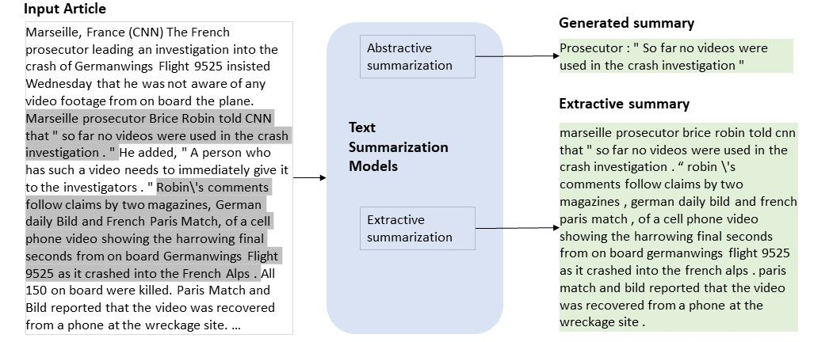
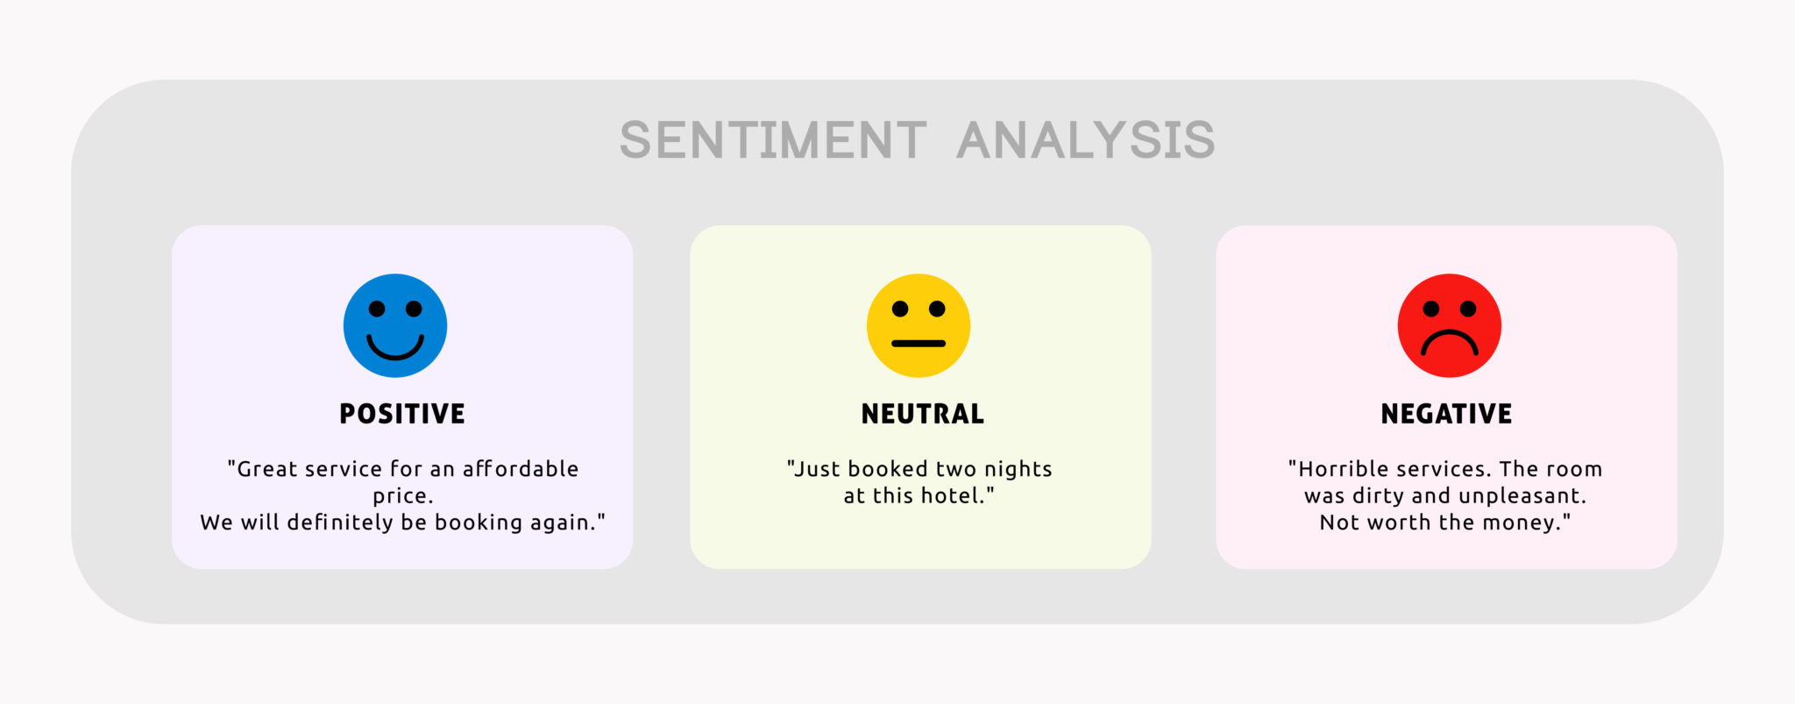
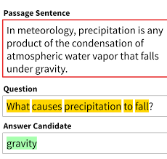
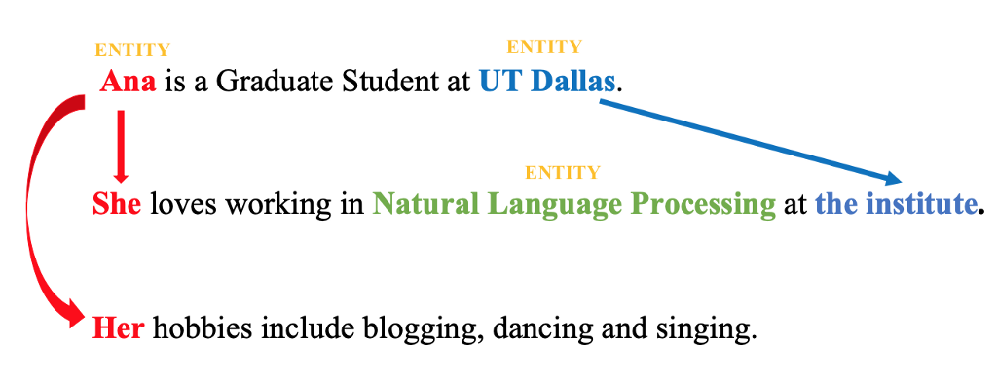
Language models are everywhere
Sentiment
Summarization
Question Answering
Coreference Resolution

Slide 12
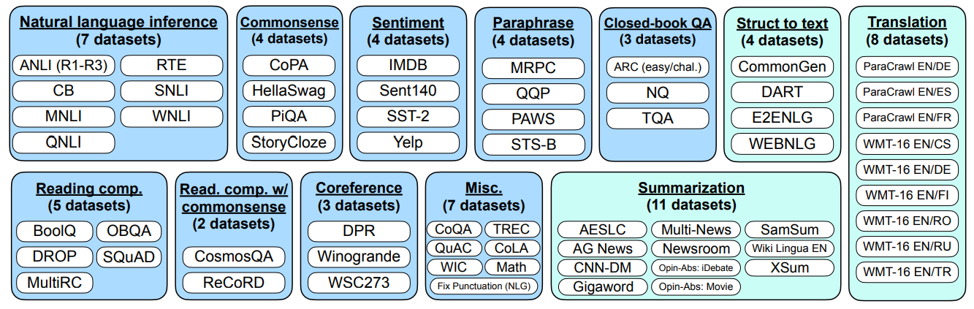
Instruction Models:
Using supervision to teach a language model (LM) to perform tasks described via instructions.
The LM will learn to follow instructions and do so even for unseen tasks.
Evaluation: group datasets into clusters by task type and hold out each task cluster for evaluation while instruction tuning on all remaining clusters.
NLU tasks in blue; NLG tasks in teal

Slide 13
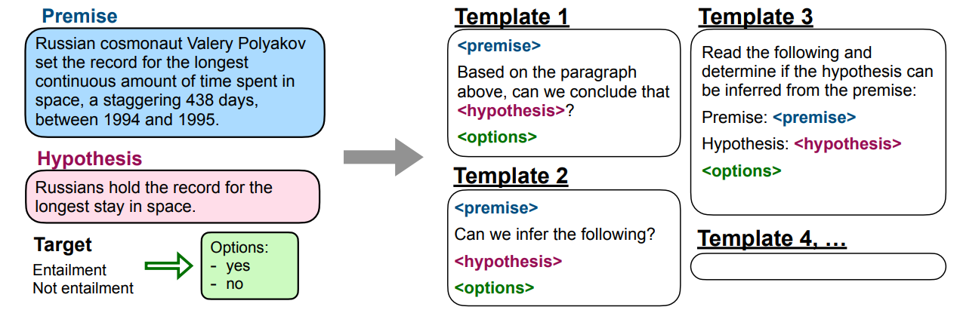
Multiple Instruction Templates for Each NLP Task
Manually compose ten unique templates that use natural language instructions to describe the task for that dataset.
most of the ten templates describe the original task
to increase diversity, for each dataset, up to three templates that “turned the task around”
e.g., for sentiment classification, summarization task related template by asking to generate a movie review

Slide 14
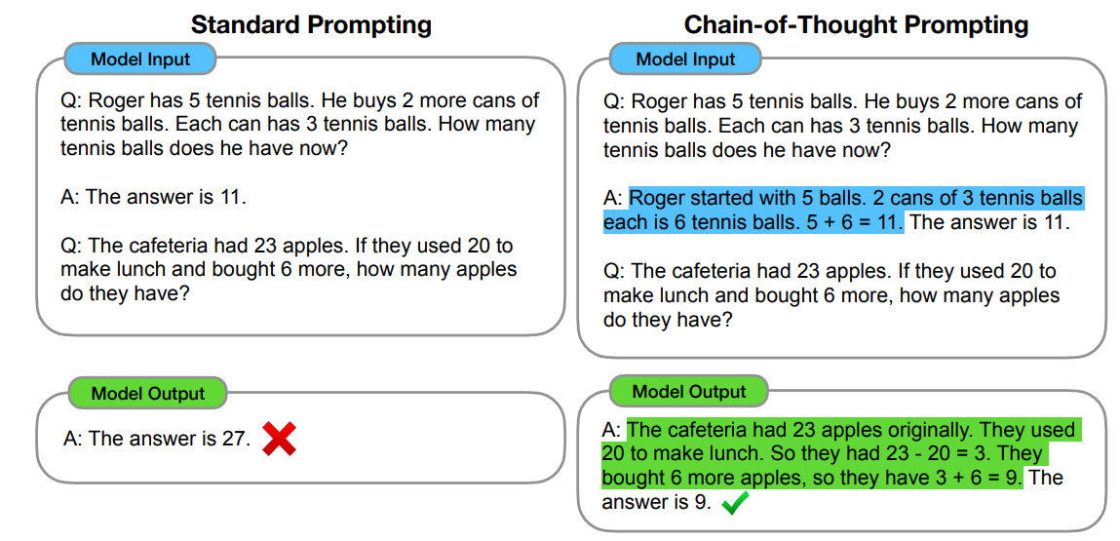
In-Context Learning and Chain-of-Thought
Jason Wei, Xuezhi Wang, Dale Schuurmans, Maarten Bosma. Chain-of-Thought Prompting Elicits Reasoning. NeurIPS, 2022.

Slide 15
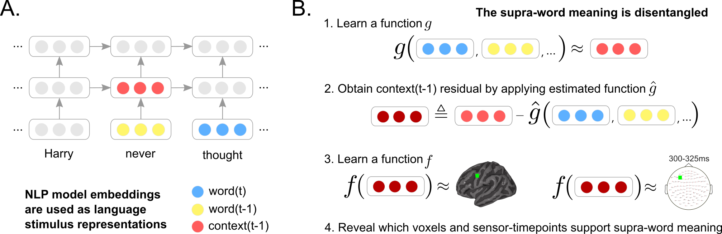

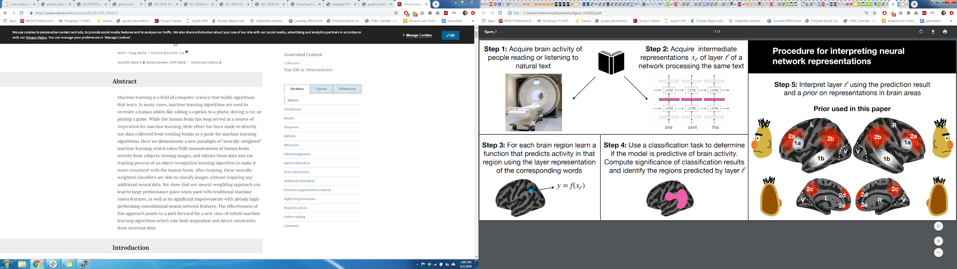
Data-driven encoding models evaluate the relationships between brains and deep learning models
Multimodal naturalistic stimulus
Deep learning system
A priori locations in DL system and brain
Data-driven encoding model
how are they related?
fMRI
Toneva, M., & Wehbe, L. (2019). Interpreting and improving natural-language processing (in machines) with natural language-processing (in the brain). Advances in Neural Information Processing Systems, 32.

Slide 16


Deep learning models enable data-driven encoding models for naturalistic stimuli
more naturalistic stimuli
simple stim. representations explain less variance in brain activity
<0,1,...0>
more stimulus properties that affect brain activity
Notes:
Naturalistic stimuli -> reading books, listening to stories, watching a movie
The properties of the stimulus that affect brain activity are increasing, so simple representations of the stimuli capture less variance of the brain activity
Meanwhile we have huge progress in deep learning in the last 10 years that gives us AI models that can do many tasks. Of course they are not perfect, and are sometimes flawed, but there is the question of whether we can use their internal representations of the world as rich stimulus representations that perhaps capture some of the properties that are also relevant for the processing in the brain.
Here comes to encoding model

Slide 17
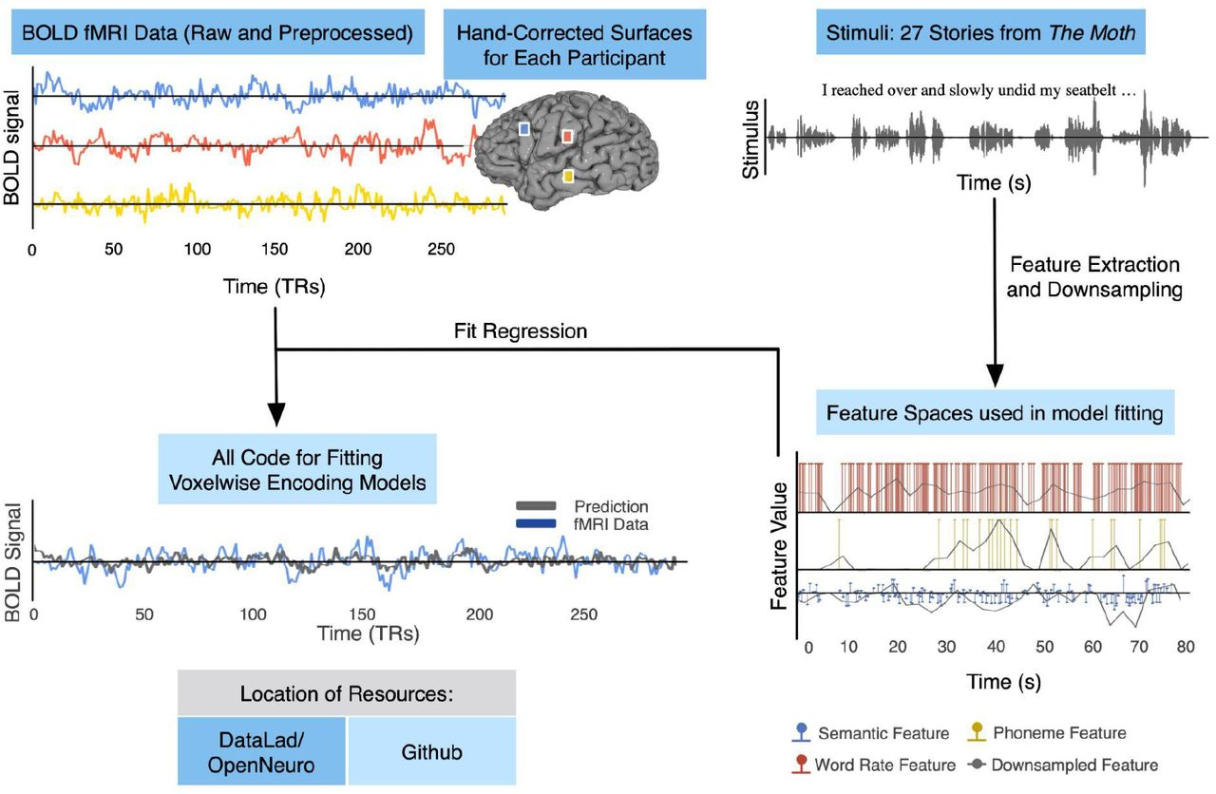
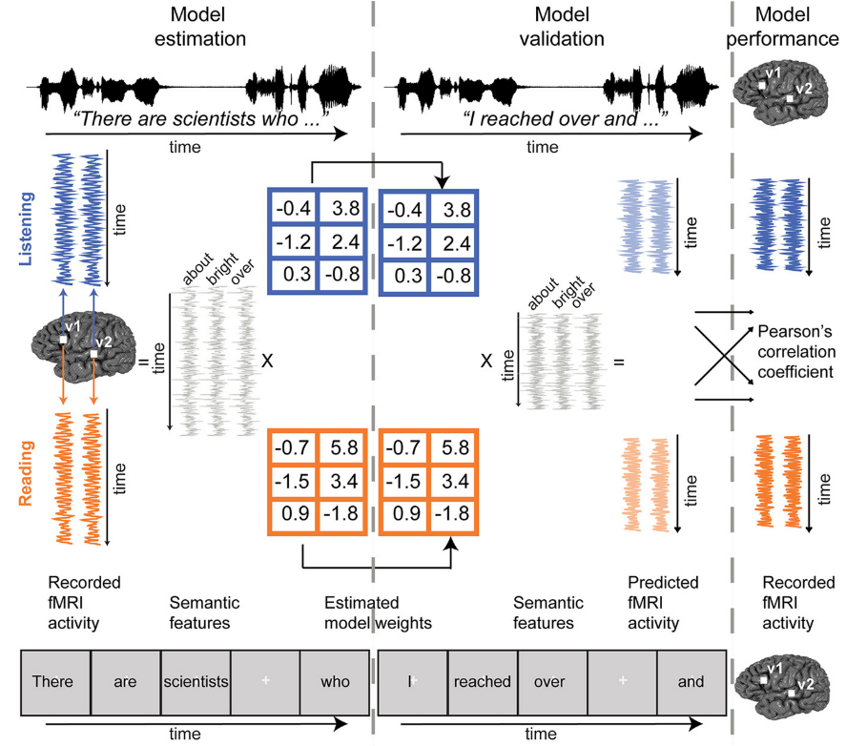
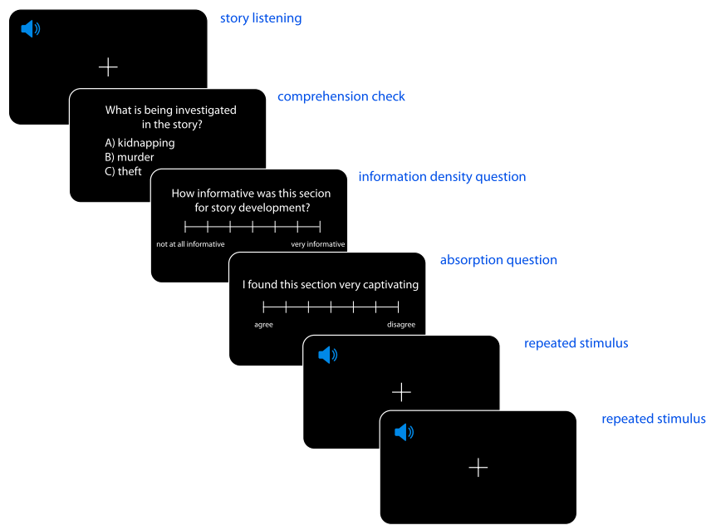
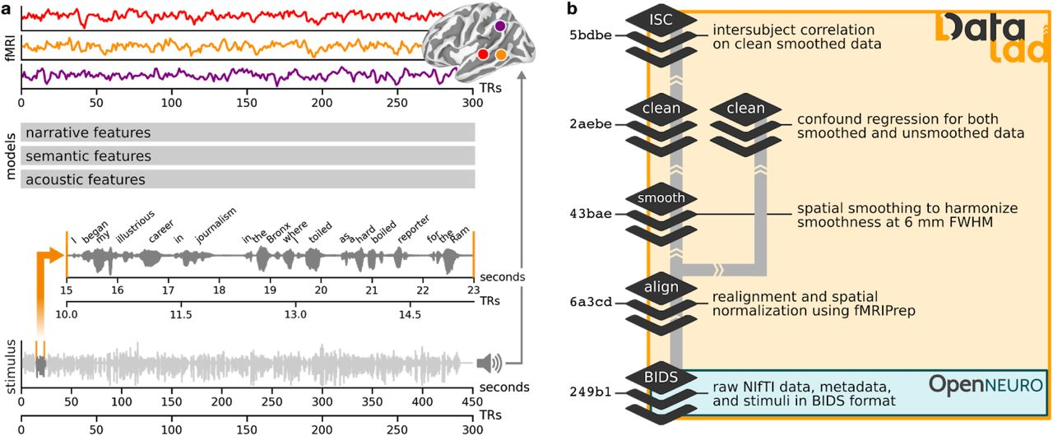
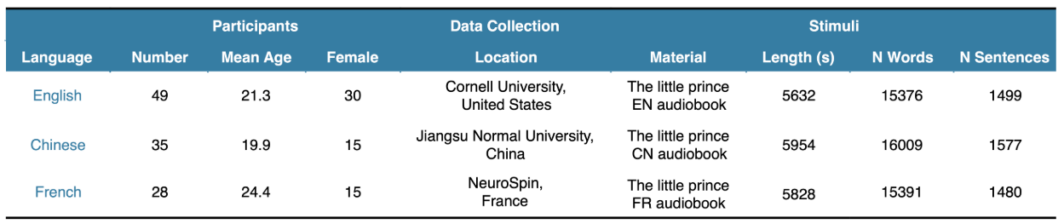
Deep learning models enable data-driven encoding models for naturalistic stimuli
Fatma Deniz, Anwar O. Nunez-Elizalde, Alexander G. Huth and Jack L. Gallant. The representation of semantic information across human cerebral cortex during listening versus reading is invariant to stimulus modality. Journal of Neuroscience, 2019.
Samuel A. Nastase. The “Narratives” fMRI dataset for evaluating models of naturalistic language comprehension. Nature, 2021.
Jixing Li. Le Petit Prince multilingual naturalistic fMRI corpus. Nature, 2022.
Amanda LeBel, Lauren Wagner, Shailee Jain, Aneesh Adhikari-Desai, Bhavin Gupta, Allyson Morgenthal, Jerry Tang, Lixiang Xu, Alexander G. Huth. A natural language fMRI dataset for voxelwise encoding models. Arxiv, 2022.
Notes:
Naturalistic stimuli -> reading books, listening to stories, watching a movie
The properties of the stimulus that affect brain activity are increasing, so simple representations of the stimuli capture less variance of the brain activity
Meanwhile we have huge progress in deep learning in the last 10 years that gives us AI models that can do many tasks. Of course they are not perfect, and are sometimes flawed, but there is the question of whether we can use their internal representations of the world as rich stimulus representations that perhaps capture some of the properties that are also relevant for the processing in the brain.
Here comes to encoding model

Slide 18
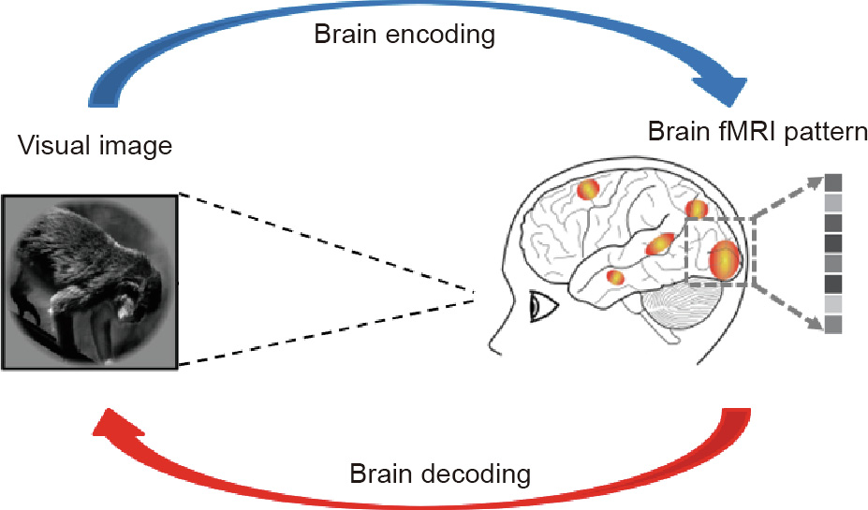
Encoding (Well-posed) vs Decoding (Ill-posed) in Neuroscience
Encoding: How is the stimulus represented in the brain?
Decoding: Can we reconstruct the stimulus, given the brain response?
Changde Du, Jinpeng Li, Lijie Huang, Huiguang He. Brain Encoding and Decoding in fMRI with Bidirectional Deep Generative Models. Science Direct 2019.

Slide 19
Encoding (Well-posed) vs Decoding (Ill-posed) in Neuroscience
Encoding: How is the stimulus represented in the brain?
Decoding: Can we reconstruct the stimulus, given the brain response?
Decoding is ill-posed?
What information is to be decoded from the brain?
Can we read what the subject is thinking while watching the stimulus?
Changde Du, Jinpeng Li, Lijie Huang, Huiguang He. Brain Encoding and Decoding in fMRI with Bidirectional Deep Generative Models. Science Direct 2019.

Slide 20
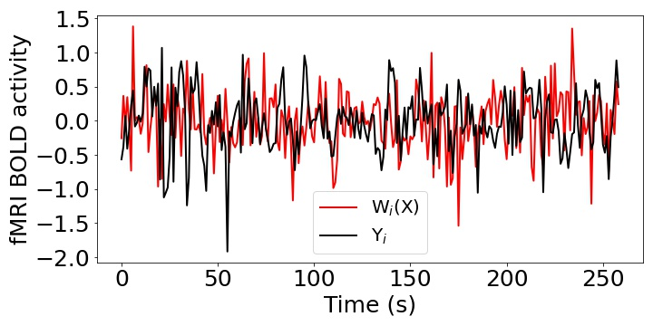
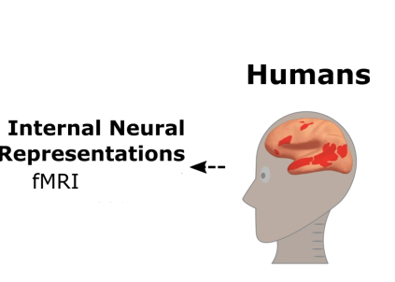
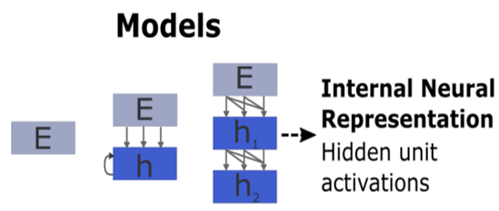
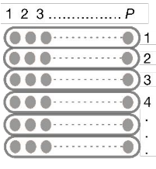
Brain Encoding?
Pearson Correlation (R) = Corr(Y, W(X))
Stimulus
Stimulus
Input
Present
X
W
Y
Input
Ridge Regression
Output

Slide 21
Encoding: training independent models
Independent model per participant
P1
P2
…
PN
Independent model per voxel / sensor-timepoint
P1, v1
P1, v2
…
P1, vm

Slide 22
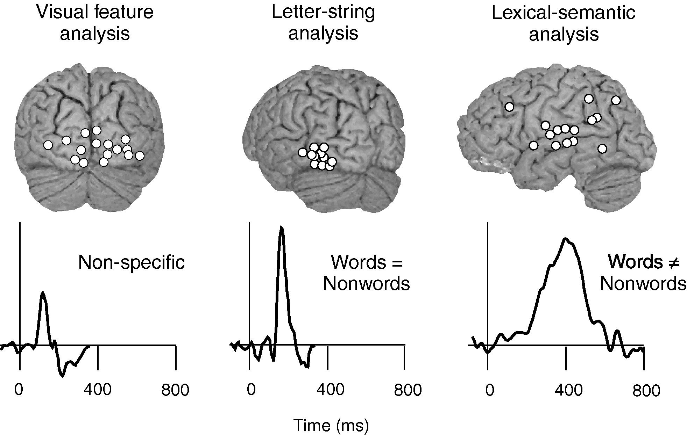
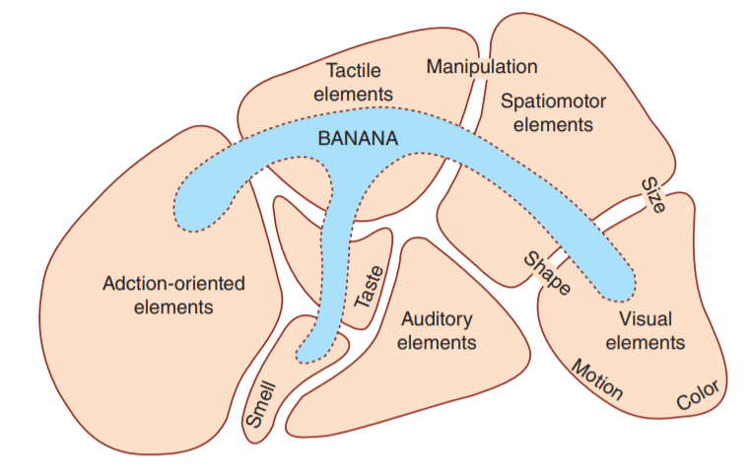
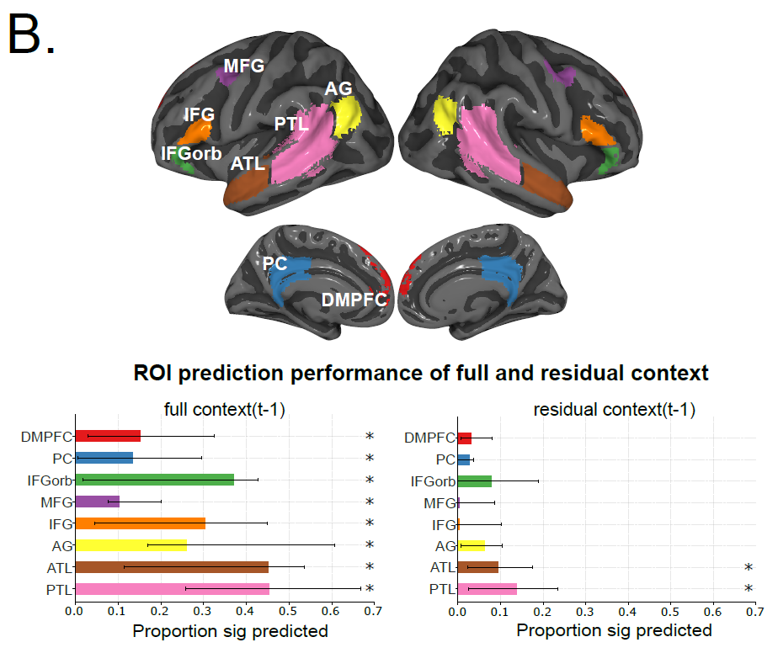
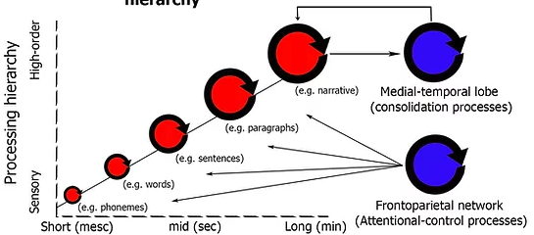
Mechanistic understanding of information processing in the brain: 4 big questions
What
When
Where
How

Slide 23
With MEG we can analyze sub-word time course
MEG recording data at very fast temporal resolution
So, we can look at sub-word process
fMRI recording data at very high-spatial resolution
When
Where

Slide 24
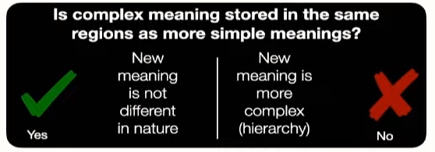
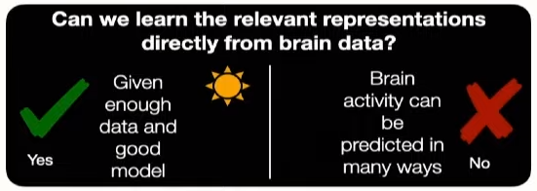
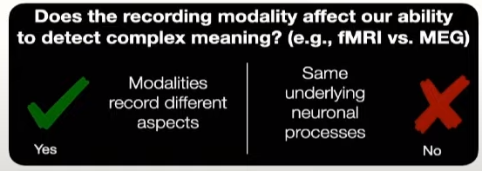
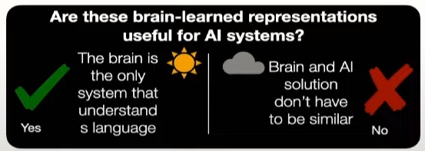
How does brain represents complex meaning? (Where, When and What)

Slide 25
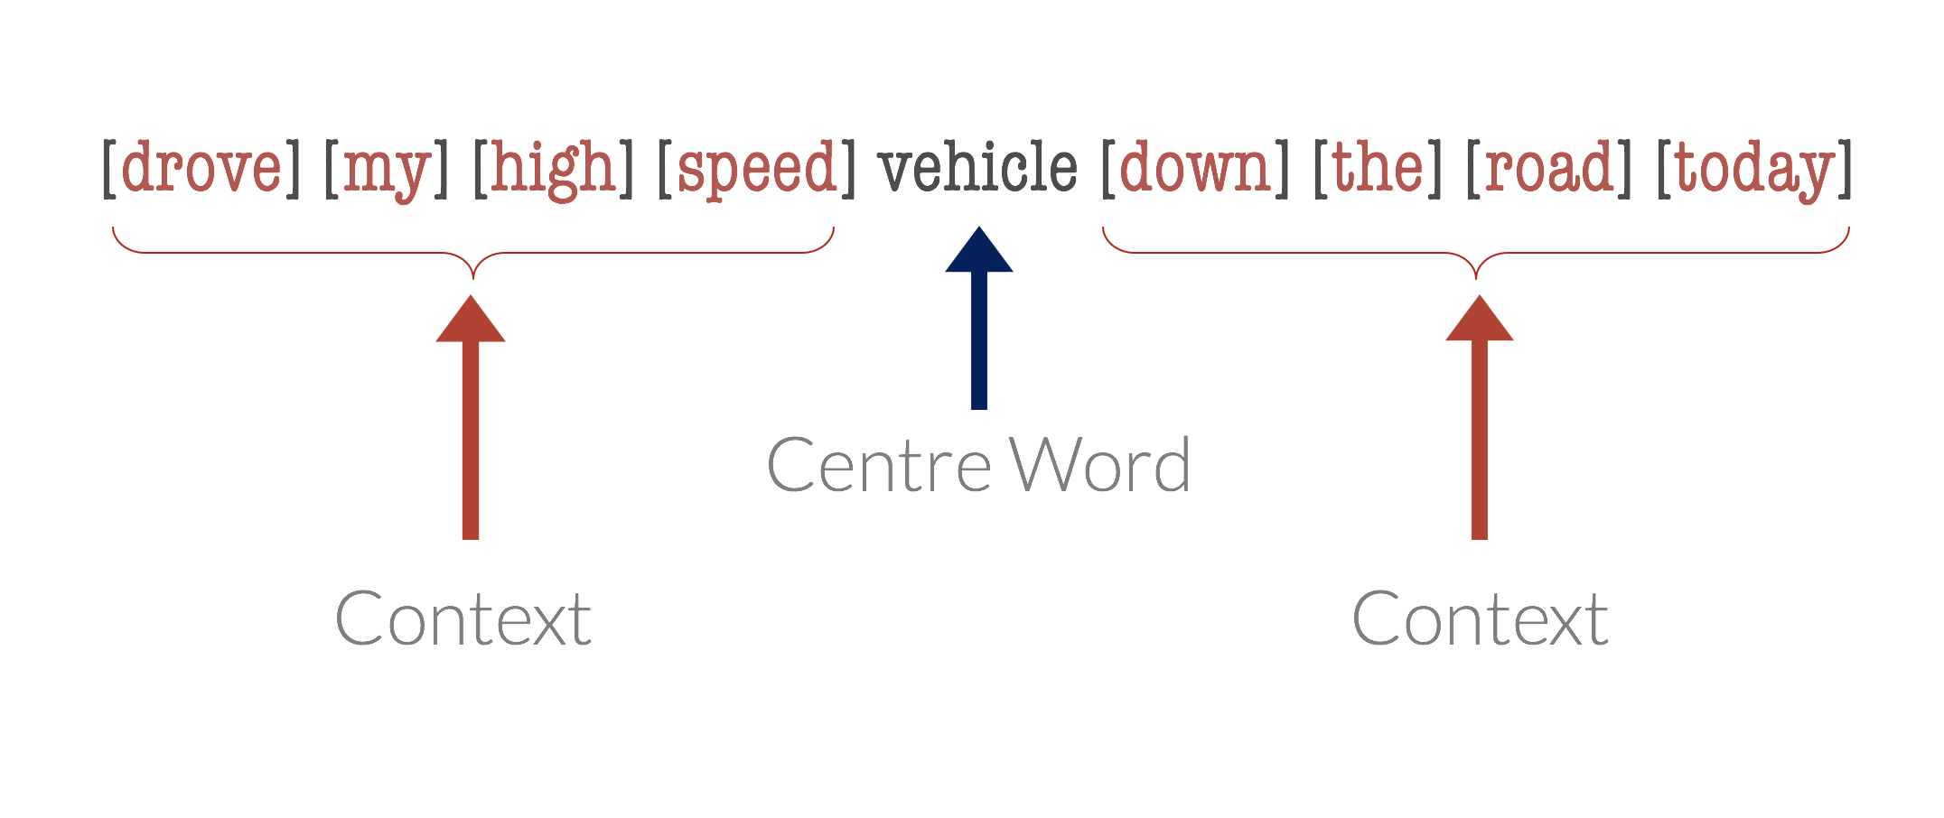
Word Context
1-word context
2-word context
3-word context
4-word context
5-word context
Past context
Future context

Slide 26
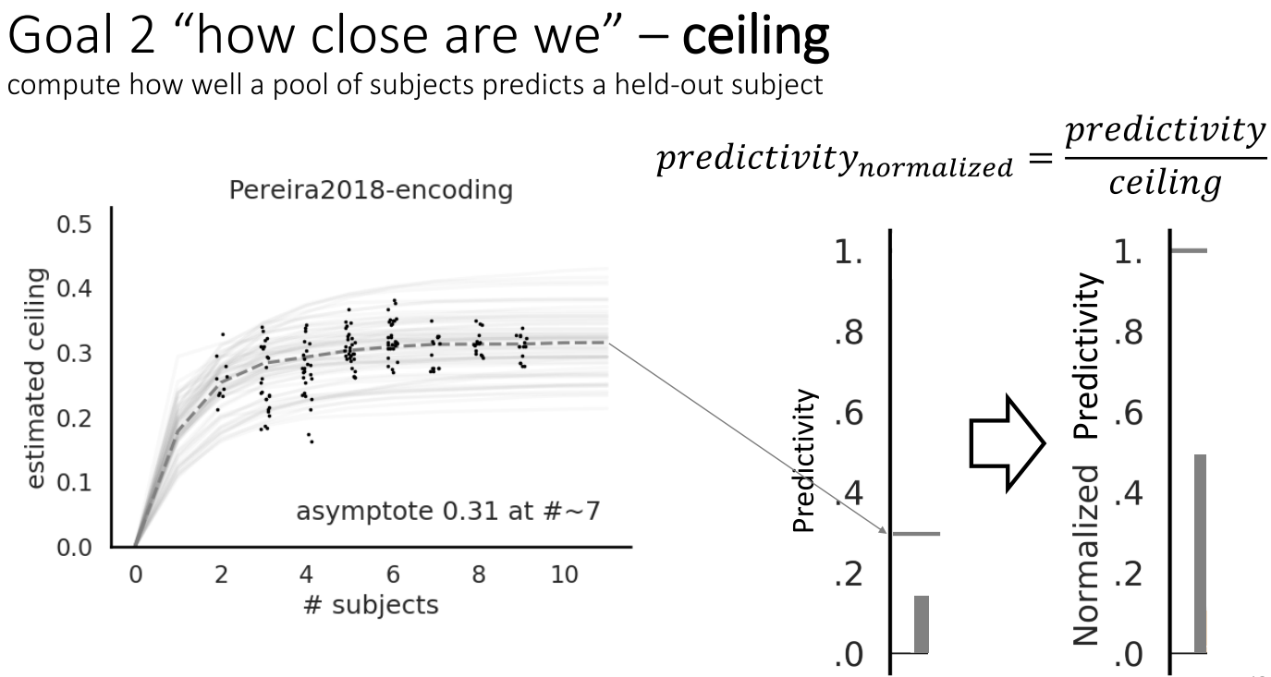
Normalized Predictivity
Schrimpf, Martin, Idan Asher Blank, Greta Tuckute, Carina Kauf, Eghbal A. Hosseini, Nancy Kanwisher, Joshua B. Tenenbaum, and Evelina Fedorenko. "The neural architecture of language: Integrative modeling converges on predictive processing." Proceedings of the National Academy of Sciences 118, no. 45 (2021): e2105646118.

Slide 27
Recent work utilizing progress in LLMs for encoding
Using representations of stimuli from deep learning systems
Language:
Wehbe et al. 2014;
Jain and Huth, 2018;
Toneva and Wehbe, 2019;
Caucheteux and King, 2020/2022;
Schrimpf et al. 2020/2021;
Goldstein et al. 2021/2022;
Toneva and Wehbe, 2022/2023;
Khai et al. 2023
Oota et al. 2022/2023;

Slide 28
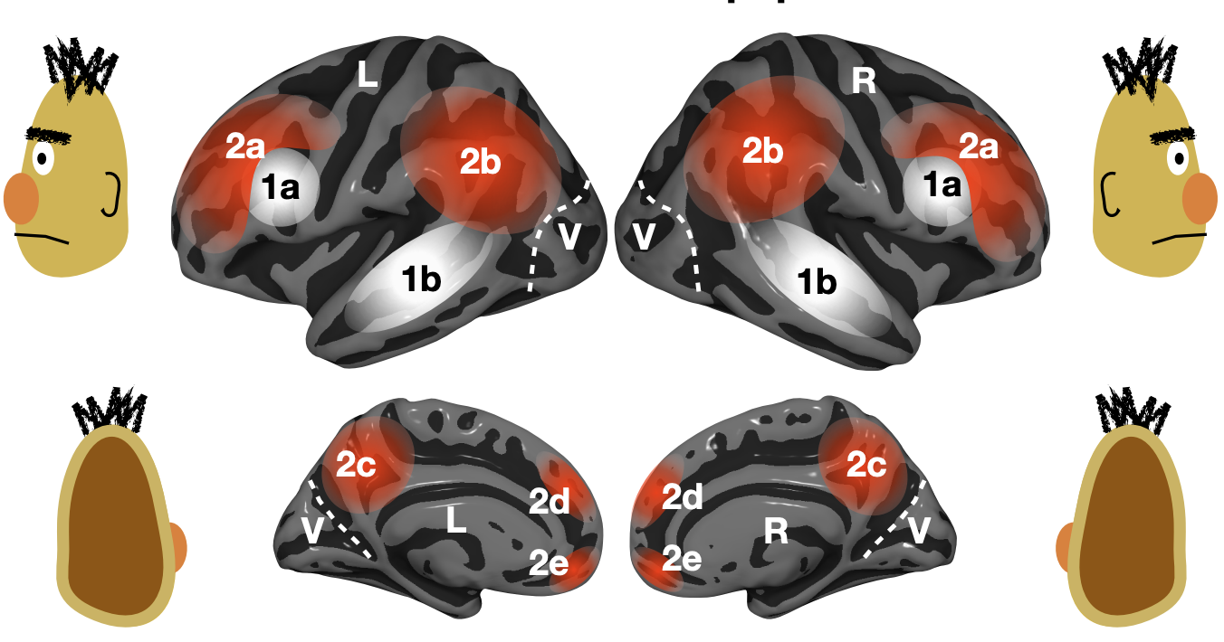
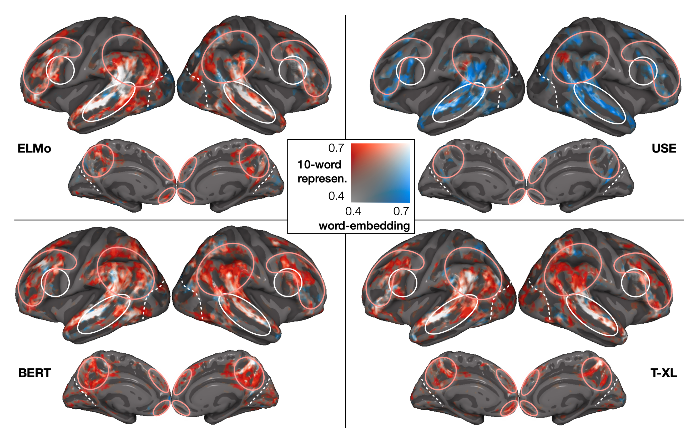
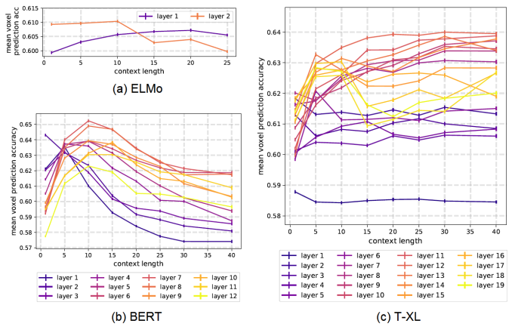
Language: work utilizing DL progress
Stimuli: one chapter of Harry Potter
Stimulus representation: derived from pretrained NLP systems
Brain recording & modality: fMRI, reading
across several types of large NLP systems, best alignment with fMRI in middle layers
Toneva, M., & Wehbe, L. (2019). Interpreting and improving natural-language processing (in machines) with natural language-processing (in the brain). Advances in Neural Information Processing Systems, 32.
Notes:
Further, in the transformer models, we find an interaction between layer depth and context length, and between layer depth and attention type. We finally hypothesize that altering BERT to better align with brain recordings would enable it to also better understand language. Probing the altered BERT using syntactic NLP tasks reveals that the model with increased brain-alignment outperforms the original model.

Slide 29
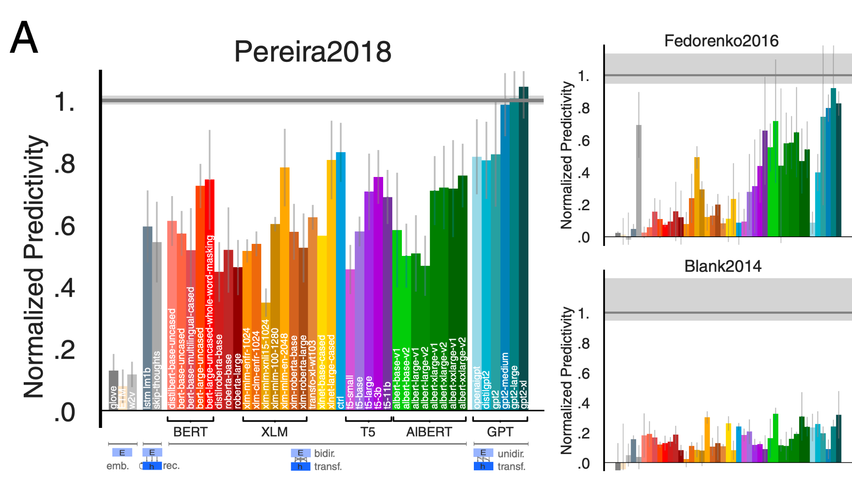
Language: work utilizing DL progress
Stimuli: sentences, passages, short story
Stimulus representation: derived from pretrained NLP systems (BERT, GPT-2, T5 , and XLM)
Brain recording & modality: fMRI & ECoG, reading & listening
some NLP systems can predict fMRI and ECoG up to 100% of estimated noise ceiling
Schrimpf, Martin, Idan Asher Blank, Greta Tuckute, Carina Kauf, Eghbal A. Hosseini, Nancy Kanwisher, Joshua B. Tenenbaum, and Evelina Fedorenko. "The neural architecture of language: Integrative modeling converges on predictive processing." Proceedings of the National Academy of Sciences 118, no. 45 (2021): e2105646118.
Notes:
The datasets varied in the imagingmodality (fMRI/ECoG), the nature of the materials (uncon-nected sentences/passages/stories), the grain of linguistic unitsto which responses were recorded (sentences/words/2-s-longstory fragments), and presentation modality (reading/listening).
We find that the most powerful models predict neural and behavioral responses across different datasets up to noise levels. Models that perform better at predicting the next word in a sequence also better predict brain measurements
Next-word-prediction task performance is predictive of reading times
Brain scores correlate with behavioral scores

Slide 30
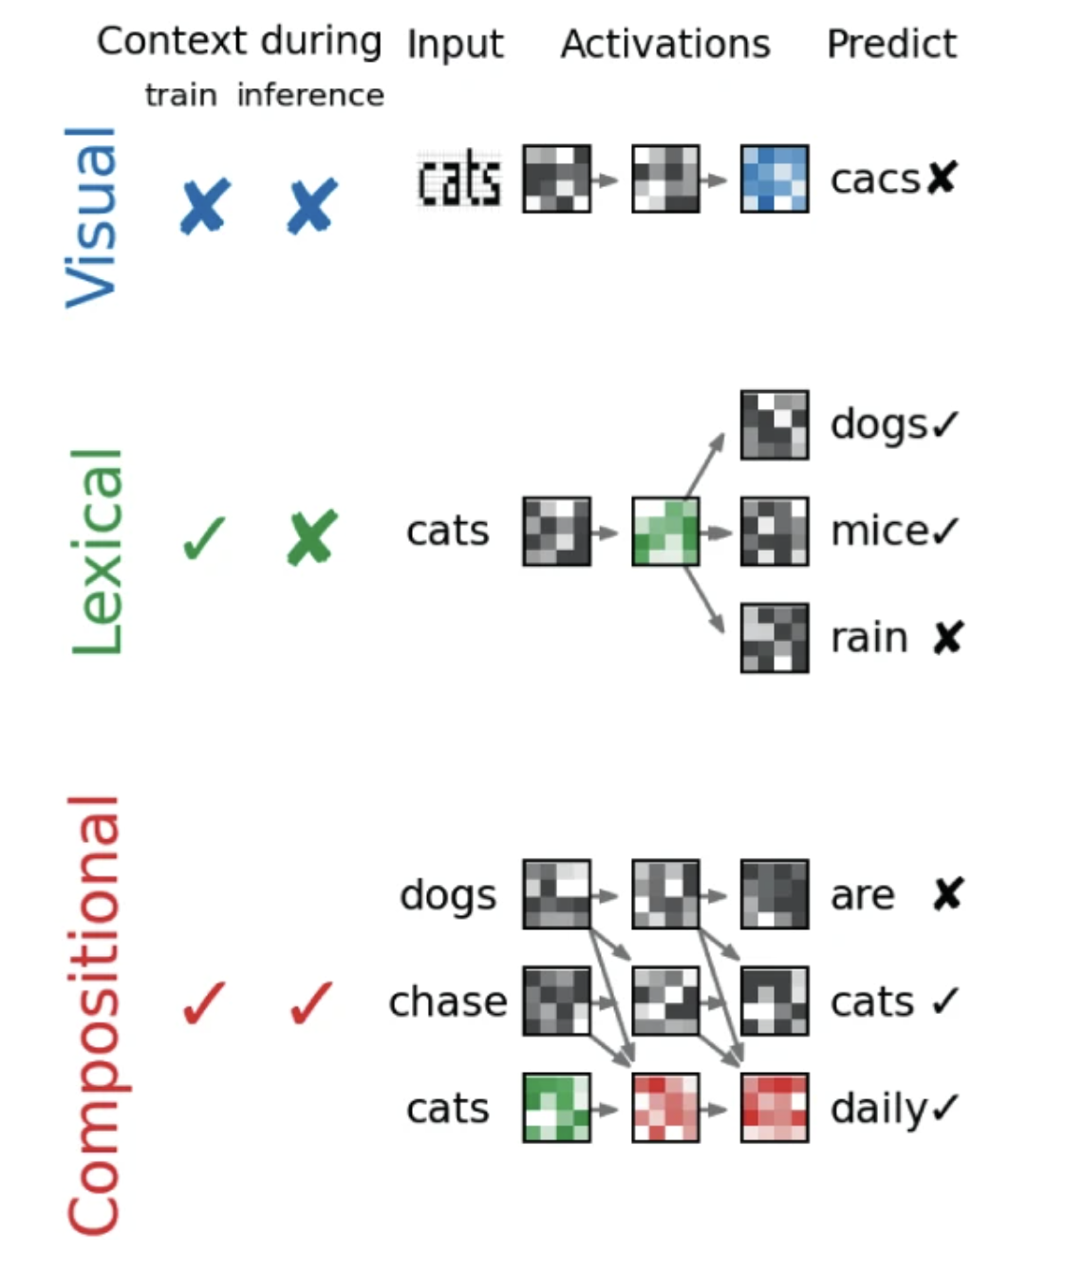
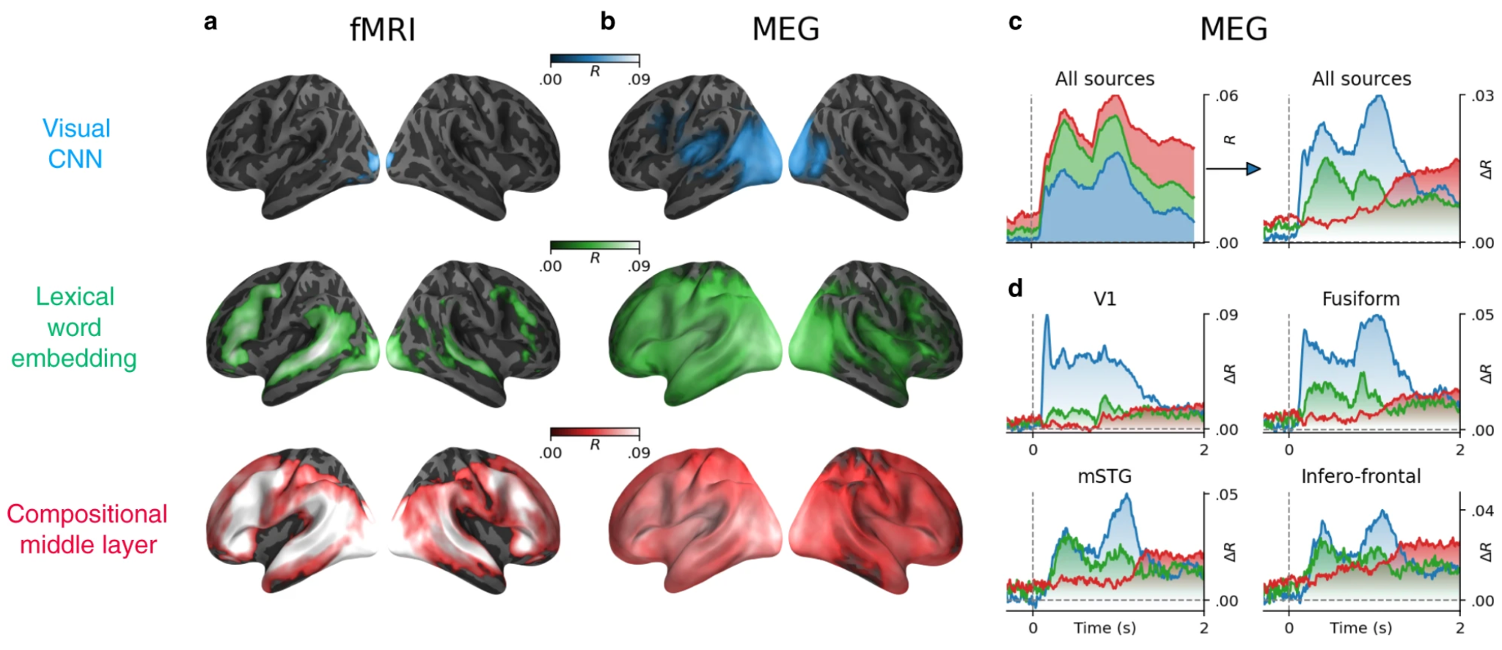
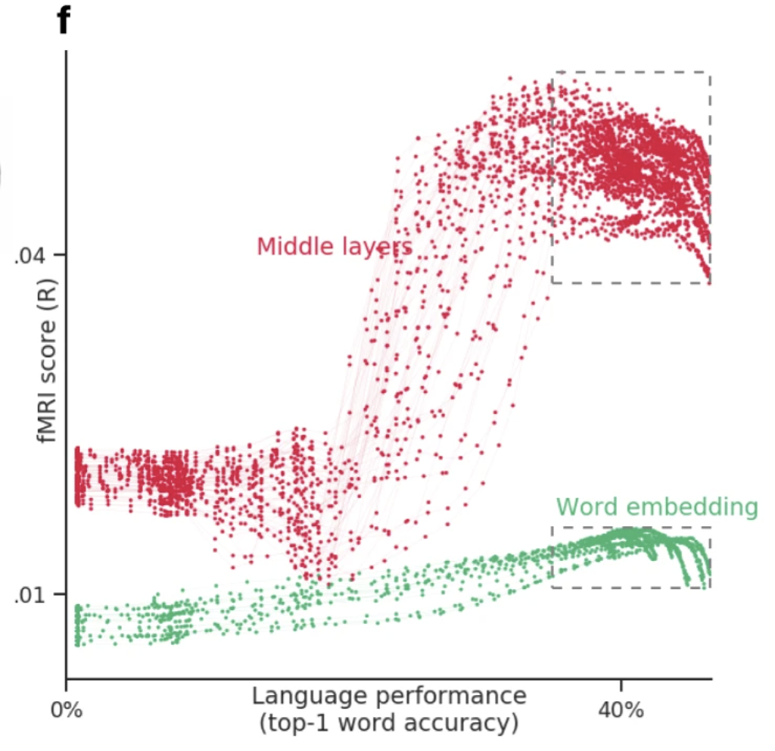
Language: work utilizing DL progress
best alignment with fMRI & MEG in middle layers
better performance at predicting next word -> better prediction of fMRI & MEG
Stimuli: sentences
Stimulus representation: derived from pretrained NLP systems (BERT and GPT-2)
Brain recording & modality: MEG & fMRI, reading
Caucheteux, Charlotte, and Jean-Rémi King. "Brains and algorithms partially converge in natural language processing." Communications biology 5, no. 1 (2022): 1-10.
Notes:
In fMRI, the brain scores of the visual embedding peak in the early visual cortex (V1) (mean brain scores across voxels: R = 0.022 ± 0.003, p < 10−11). By contrast, the brain scores of lexical embedding peak in the left superior temporal gyrus (R = 0.052 ± 0.004, p < 10−13) as well as in the inferior temporal cortex and middle frontal gyrus (R = 0.053 ± 0.003, p < 10−15) and are significant across the entire language and reading network (Fig. 3b). Finally, the brain scores of the compositional embedding are significantly higher than those of lexical of embeddings in the superior temporal gyrus (ΔR = 0.012 ± 0.001, p < 10−16), the angular gyrus (ΔR = 0.010 ± 0.001, p < 10−16), the infero-frontal cortex (ΔR = 0.016 ± 0.001, p < 10−16) and the dorsolateral prefrontal cortex (ΔR = 0.012 ± 0.001, p < 10−13). While these effects are lateralized (left hemisphere versus right hemisphere: ΔR = 0.010 ± 0.001, p < 10−14), they are significant across a remarkably large number of bilateral areas (Fig. 3b). Lexical and compositional embeddings accurately predict brain responses in the early visual cortex. This result is not necessarily surprising: language embeddings encode features (e.g., position of words in the sentence, beginning/end of the sentence) that correlate with visual information (words are flashed at a screen, and the sentences are separated by pauses). Critically, the gain (ΔR) of these embeddings remain very small, suggesting that this effect is mainly driven by the covariance between low-level and high-level representations of words.
To characterize the dynamics of these brain representations, we perform the same analysis using source-localized MEG recordings. The resulting brain scores are consistent with—although less spatially precise than—the above fMRI results (Fig. 3c, average brain score between 0 and 2 s). For clarity, Fig. 3d and Supplementary Movie 2 plot the gain in MEG scores: i.e., the difference of prediction performance between i) word and visual embeddings (green) and ii) the difference between compositional and word embedding (red). The brain scores of the visual embedding peak around 100 ms in V1 (R = 0.008 ± 0.002, p < 10−3), and rapidly propagate to higher-level areas (Fig. 3d and Supplementary Movie 2). The gain achieved by the word embedding can be observed in the left posterior fusiform gyrus around 200 ms and peaks around 400 ms and in the left temporal and frontal cortices. Finally, the gain achieved by the compositional embedding is observed in a large number of bilateral brain regions, and peaks around 1 s after word onset (Fig. 3c, d).
After that period, brain areas outside the language network, such as area V1, appear to be better predicted by word and compositional embeddings than by visual ones (e.g., between visual and word in V1: ΔR = 0.016 ± 0.002, p < 10−10). These effects could thus reflect feedback activity45 and explain why the corresponding fMRI responses are better accounted for by word and compositional embeddings than by visual ones.
Second, brain scores strongly correlate with language accuracy in both MEG (R = 0.77 Pearson’s correlation on average ± 0.01 across subjects) and fMRI (R = 0.57 ± 0.02, Fig. 4b, c). The correlation is highest for middle (fMRI: R = 0.81 ± 0.02; MEG: R = 0.86 ± 0.01) than input (fMRI: R = 0.39 ± 0.03; MEG: R = 0.73 ± 0.02) and output layers (fMRI: R = 0.63 ± 0.03; MEG:R = 0.78 ± 0.02). Beta

Slide 31

Language: work utilizing DL progress
best alignment with fMRI & MEG in middle layers
better performance at predicting next word -> better prediction of fMRI & MEG
Stimuli: sentences
Stimulus representation: derived from pretrained NLP systems (BERT and GPT-2)
Brain recording & modality: MEG & fMRI, reading
Caucheteux, Charlotte, and Jean-Rémi King. "Brains and algorithms partially converge in natural language processing." Communications biology 5, no. 1 (2022): 1-10.
Notes:
In fMRI, the brain scores of the visual embedding peak in the early visual cortex (V1) (mean brain scores across voxels: R = 0.022 ± 0.003, p < 10−11). By contrast, the brain scores of lexical embedding peak in the left superior temporal gyrus (R = 0.052 ± 0.004, p < 10−13) as well as in the inferior temporal cortex and middle frontal gyrus (R = 0.053 ± 0.003, p < 10−15) and are significant across the entire language and reading network (Fig. 3b). Finally, the brain scores of the compositional embedding are significantly higher than those of lexical of embeddings in the superior temporal gyrus (ΔR = 0.012 ± 0.001, p < 10−16), the angular gyrus (ΔR = 0.010 ± 0.001, p < 10−16), the infero-frontal cortex (ΔR = 0.016 ± 0.001, p < 10−16) and the dorsolateral prefrontal cortex (ΔR = 0.012 ± 0.001, p < 10−13). While these effects are lateralized (left hemisphere versus right hemisphere: ΔR = 0.010 ± 0.001, p < 10−14), they are significant across a remarkably large number of bilateral areas (Fig. 3b). Lexical and compositional embeddings accurately predict brain responses in the early visual cortex. This result is not necessarily surprising: language embeddings encode features (e.g., position of words in the sentence, beginning/end of the sentence) that correlate with visual information (words are flashed at a screen, and the sentences are separated by pauses). Critically, the gain (ΔR) of these embeddings remain very small, suggesting that this effect is mainly driven by the covariance between low-level and high-level representations of words.
To characterize the dynamics of these brain representations, we perform the same analysis using source-localized MEG recordings. The resulting brain scores are consistent with—although less spatially precise than—the above fMRI results (Fig. 3c, average brain score between 0 and 2 s). For clarity, Fig. 3d and Supplementary Movie 2 plot the gain in MEG scores: i.e., the difference of prediction performance between i) word and visual embeddings (green) and ii) the difference between compositional and word embedding (red). The brain scores of the visual embedding peak around 100 ms in V1 (R = 0.008 ± 0.002, p < 10−3), and rapidly propagate to higher-level areas (Fig. 3d and Supplementary Movie 2). The gain achieved by the word embedding can be observed in the left posterior fusiform gyrus around 200 ms and peaks around 400 ms and in the left temporal and frontal cortices. Finally, the gain achieved by the compositional embedding is observed in a large number of bilateral brain regions, and peaks around 1 s after word onset (Fig. 3c, d).
After that period, brain areas outside the language network, such as area V1, appear to be better predicted by word and compositional embeddings than by visual ones (e.g., between visual and word in V1: ΔR = 0.016 ± 0.002, p < 10−10). These effects could thus reflect feedback activity45 and explain why the corresponding fMRI responses are better accounted for by word and compositional embeddings than by visual ones.
Second, brain scores strongly correlate with language accuracy in both MEG (R = 0.77 Pearson’s correlation on average ± 0.01 across subjects) and fMRI (R = 0.57 ± 0.02, Fig. 4b, c). The correlation is highest for middle (fMRI: R = 0.81 ± 0.02; MEG: R = 0.86 ± 0.01) than input (fMRI: R = 0.39 ± 0.03; MEG: R = 0.73 ± 0.02) and output layers (fMRI: R = 0.63 ± 0.03; MEG:R = 0.78 ± 0.02). Beta

Slide 32


Language: work utilizing DL progress
model-selected ‘out-of- distribution’ sentences indeed drive and suppress activity of human language areas in new individuals
Stimuli: sentences
Stimulus representation: derived from pretrained NLP systems (GPT-2 XL)
Brain recording & modality: fMRI, reading
Greta Tuckute et al. 2023. "Driving and suppressing the human language network using large language models."
Notes:
In fMRI, the brain scores of the visual embedding peak in the early visual cortex (V1) (mean brain scores across voxels: R = 0.022 ± 0.003, p < 10−11). By contrast, the brain scores of lexical embedding peak in the left superior temporal gyrus (R = 0.052 ± 0.004, p < 10−13) as well as in the inferior temporal cortex and middle frontal gyrus (R = 0.053 ± 0.003, p < 10−15) and are significant across the entire language and reading network (Fig. 3b). Finally, the brain scores of the compositional embedding are significantly higher than those of lexical of embeddings in the superior temporal gyrus (ΔR = 0.012 ± 0.001, p < 10−16), the angular gyrus (ΔR = 0.010 ± 0.001, p < 10−16), the infero-frontal cortex (ΔR = 0.016 ± 0.001, p < 10−16) and the dorsolateral prefrontal cortex (ΔR = 0.012 ± 0.001, p < 10−13). While these effects are lateralized (left hemisphere versus right hemisphere: ΔR = 0.010 ± 0.001, p < 10−14), they are significant across a remarkably large number of bilateral areas (Fig. 3b). Lexical and compositional embeddings accurately predict brain responses in the early visual cortex. This result is not necessarily surprising: language embeddings encode features (e.g., position of words in the sentence, beginning/end of the sentence) that correlate with visual information (words are flashed at a screen, and the sentences are separated by pauses). Critically, the gain (ΔR) of these embeddings remain very small, suggesting that this effect is mainly driven by the covariance between low-level and high-level representations of words.
To characterize the dynamics of these brain representations, we perform the same analysis using source-localized MEG recordings. The resulting brain scores are consistent with—although less spatially precise than—the above fMRI results (Fig. 3c, average brain score between 0 and 2 s). For clarity, Fig. 3d and Supplementary Movie 2 plot the gain in MEG scores: i.e., the difference of prediction performance between i) word and visual embeddings (green) and ii) the difference between compositional and word embedding (red). The brain scores of the visual embedding peak around 100 ms in V1 (R = 0.008 ± 0.002, p < 10−3), and rapidly propagate to higher-level areas (Fig. 3d and Supplementary Movie 2). The gain achieved by the word embedding can be observed in the left posterior fusiform gyrus around 200 ms and peaks around 400 ms and in the left temporal and frontal cortices. Finally, the gain achieved by the compositional embedding is observed in a large number of bilateral brain regions, and peaks around 1 s after word onset (Fig. 3c, d).
After that period, brain areas outside the language network, such as area V1, appear to be better predicted by word and compositional embeddings than by visual ones (e.g., between visual and word in V1: ΔR = 0.016 ± 0.002, p < 10−10). These effects could thus reflect feedback activity45 and explain why the corresponding fMRI responses are better accounted for by word and compositional embeddings than by visual ones.
Second, brain scores strongly correlate with language accuracy in both MEG (R = 0.77 Pearson’s correlation on average ± 0.01 across subjects) and fMRI (R = 0.57 ± 0.02, Fig. 4b, c). The correlation is highest for middle (fMRI: R = 0.81 ± 0.02; MEG: R = 0.86 ± 0.01) than input (fMRI: R = 0.39 ± 0.03; MEG: R = 0.73 ± 0.02) and output layers (fMRI: R = 0.63 ± 0.03; MEG:R = 0.78 ± 0.02). Beta

Slide 33
Challenges in using DL for cognitive science
Not designed to specifically model brain processing
NLP systems: Designed to predict upcoming words
Harry never thought ???
Harry never thought he ???
Harry never thought he would ???
...

Slide 34
Challenges in using DL for cognitive science
Not designed to specifically model brain processing
Training DL models using brain recordings
Task-based modeling

Slide 35
Challenges in using DL for cognitive science
Not designed to specifically model brain processing
Training DL models using brain recordings
Task-based modeling
Can be difficult to interpret due to multiple sources of information
part-of-speech
+
semantic role
?
+
dependence on other words
+
...

Slide 36
Challenges in using DL for cognitive science
Not designed to specifically model brain processing
Training DL models using brain recordings
Task-based modeling
Can be difficult to interpret due to multiple sources of information
Disentangling contributions of different info sources to brain predictions

Slide 37
Challenges in using DL for cognitive science
Not designed to specifically model brain processing
Training DL models using brain recordings
Task-based modeling
Can be difficult to interpret due to multiple sources of information
Disentangling contributions of different info sources to brain predictions

Slide 38

Training DL models using brain recordings
Stimuli: one chapter of Harry Potter
Stimulus representation: brain-optimized NLP model
Brain recording & modality: fMRI & MEG, reading
Chapter of a book
NLP system
A priori locations in NLP system and brain
error propagation
Brain-optimized NLP model predicts unseen fMRI recordings better, especially in canonical language regions
𝑥 alignment
fMRI
Schwartz, Dan, Mariya Toneva, and Leila Wehbe. "Inducing brain-relevant bias in natural language processing models." Advances in neural information processing systems 32 (2019).
Notes:
we presented an approach that directly introduced brain-relevant language bias in an NLP model by explicitly training an NLP model to predict language-induced brain recordings. To achieve this, we fine-tuned all parameters of a state-of-the-art NLP model, which was already pre-trained in a self-supervised fashion on a large amount of text, to predict two different types of brain imaging measurements---fMRI and Magnetoencephalography (MEG)---of people reading the same chapter of a popular book. We included two different imaging modalities to discourage the encoded bias' dependence on a specific imaging modality. In fact, we showed that for some participants, when a model is trained to predict MEG data, the resulting changes to the language-encoding that the model uses benefit subsequent training on fMRI data compared to starting with a language model trained only on text. This suggests that the changes to the language representations induced by the MEG data are not entirely imaging modality-specific, and that indeed the model is learning the relationship between language and brain activity as opposed to the relationship between language and a brain activity recording modality. We showed that the resulting model leads to improved prediction of previously unseen brain recordings, specifically in regions that are known to support language processing. This study demonstrates the feasibility of directly biasing language models to learn relationships between text and brain activity.

Slide 39


Inducing Brain Relevant Bias
Schwartz, Dan, Mariya Toneva, and Leila Wehbe. "Inducing brain-relevant bias in natural language processing models." Advances in neural information processing systems 32 (2019).

Slide 40
Challenges in using DL for cognitive science
Not designed to specifically model brain processing
Training DL models using brain recordings
Task-based modeling
Can be difficult to interpret due to multiple sources of information
Disentangling contributions of different info sources to brain predictions

Slide 41




Tasks affect processing
bear
306 sensors
X
800ms
Can we model as a function of the task AND stimulus?
veg?
Systematic difference due to different question tasks
bear
306 sensors
X
800ms
tool?
Attention emphasizes task-relevant information
Mechanism?
Toneva, Mariya, Otilia Stretcu, Barnabás Póczos, Leila Wehbe, and Tom M. Mitchell. "Modeling task effects on meaning representation in the brain via zero-shot meg prediction." Advances in Neural Information Processing Systems 33 (2020): 5284-5295.

Slide 42

Tasks affect processing
The end of semantic processing of a word is task-dependent
Stimuli: concrete nouns + line drawings
Task: answer Yes/No questions about noun
Stimulus representation: human judgments
Brain recording & modality: MEG, reading
question task effect word effect
significant prediction performance
Toneva, Mariya, Otilia Stretcu, Barnabás Póczos, Leila Wehbe, and Tom M. Mitchell. "Modeling task effects on meaning representation in the brain via zero-shot meg prediction." Advances in Neural Information Processing Systems 33 (2020): 5284-5295.

Slide 43



Neural Language Taskonomy: Which NLP Tasks are the most Predictive of fMRI Brain Activity
July 13, 2022
NAACL-HLT 2022
Subba Reddy Oota^{1,2}, Jashn Arora², Veeral Agarwal², Mounika Marreddy², Manish Gupta^{2,3}, Bapi Raju Surampudi²
¹Inria Bordeaux France, ²IIIT-Hyderabad, ³Microsoft India

Slide 44
Can task-specific language models better predict fMRI brain activity?
Tasks
Paraphrase
Summrisation
Question Answering
Sentiment Analysis
NER
Word Sense Disambiguation
Natural Language Inference
Semantic Role Labeling
Coreference Resolution
Shallow Syntax
Pretrained BERT
Syntactic
Devlin et al. 2019, Bowon et al. 2020
Notes:
In this study, we investigate the correlation between brain activation and feature representa- tions learned by different task-specific networks, and ask which tasks lead to improvements in brain-encoding performance.
Our selection of these tasks was based on the following design principles:
(1) We wanted to select a set of tasks covering diverse cognitive-linguistic skills.
(2) We wanted to select tasks that are a part of popular NLP benchmarks like GLUE
The emerging evidence from fMRI studies both syntax and semantics is distributed in the brain Thus, in this work, we explore syntactic and semantic tasks separately. Of the above mentioned tasks, NER and SS are syntactic, while the others involve semantic reasoning.

Slide 45

Can task-specific language models have similar predictive performance in reading and listening?

Slide 46


Tasks affect processing
Stimuli: passages and narratives
Stimulus representation: task-optimized NLP models for a range of tasks
Brain recording & modality: fMRI, reading & listening of different stimuli
Reading fMRI best explained by coref. resolution, NER, shallow syntax parsing
Listening fMRI best explained by paraphrasing, summarization, NLI
Oota, Subba Reddy, Jashn Arora, Veeral Agarwal, Mounika Marreddy, Manish Gupta, and Bapi Raju Surampudi. "Neural Language Taskonomy: Which NLP Tasks are the most Predictive of fMRI Brain Activity?." arXiv preprint arXiv:2205.01404 (2022).
Notes:
Features from coreference resolution, NER, and shallow syntax parsing explain greater variance for the reading activity. On the other hand, for the listening activity, tasks such as paraphrase generation, summarization, and natural language inference show better encoding performance
And obv different experiments with different stimuli
Need better all tasks annotated on the same initial dataset

Slide 47
Challenges in using DL for cognitive science
Not designed to specifically model brain processing
Training DL models using brain recordings
Task-based modeling
Can be difficult to interpret due to multiple sources of information
Disentangling contributions of different info sources to brain predictions

Slide 48


Disentangling contributions of different info sources to brain predictions
“Mary finished the apple”
Isolating supra-word meaning is a type of intervention
supra-word meaning may contain concept of:
eating
apple core
…
supra-word
meaning
Toneva, Mariya, Tom M. Mitchell, and Leila Wehbe. "Combining computational controls with natural text reveals new aspects of meaning composition." BioRxiv (2020).

Slide 49
Disentangling contributions of different info sources to brain predictions
Stimuli: one chapter of Harry Potter
Stimulus representation: disentangled embeddings from pretrained NLP models
Brain recording & modality: fMRI & MEG, reading
full context
supra-word
Bilateral PTL and ATL process supra-word meaning
Word-level information important for prediction of most language regions
Toneva, Mariya, Tom M. Mitchell, and Leila Wehbe. "Combining computational controls with natural text reveals new aspects of meaning composition." BioRxiv (2020).
Notes:
True for different NLP models
True for different stimuli: watching movie vs reading a book

Slide 50


Disentangling contributions of different info sources to brain predictions
Stimuli: one chapter of Harry Potter
Stimulus representation: syntactic tree representations & pretrained NLP model
Brain recording & modality: fMRI, reading
Syntactic structure-based features explain additional variance in language regions over complexity metrics
Regions predicted by syntactic and semantic are difficult to distinguish
Reddy, Aniketh Janardhan, and Leila Wehbe. "Can fMRI reveal the representation of syntactic structure in the brain?." Advances in Neural Information Processing Systems 34 (2021): 9843-9856.
Notes:
In this study, we propose novel multi-dimensional features that encode information about the syntactic structure of sentences.
First, we find that our syntactic structure-based features explain additional variance in the brain activity of various parts of the language system, even after controlling for complexity metrics that capture processing load.
At the same time, we see that regions well-predicted by syntactic features are distributed in the language system and are not distinguishable from those processing semantics.

Slide 51


Disentangling contributions of different info sources to brain predictions
Stimuli: Narratives
Stimulus representation: syntactic tree representations & pretrained NLP model
Brain recording & modality: fMRI, listening
Constituency tree structure is better in temporal cortex and MFG, while Dependency structure is better in AG and PCC,
Regions predicted by syntactic and semantic are difficult to distinguish
Oota, Subba Reddy et al. 2022 "How distinct are Syntactic and Semantic Representations in the Brain During Sentence Comprehension?" SNL 2022
Notes:
In this study, we propose novel multi-dimensional features that encode information about the syntactic structure of sentences.
First, we find that our syntactic structure-based features explain additional variance in the brain activity of various parts of the language system, even after controlling for complexity metrics that capture processing load.
At the same time, we see that regions well-predicted by syntactic features are distributed in the language system and are not distinguishable from those processing semantics.

Slide 52

Joint processing of linguistic properties in brains and language models
Subba reddy Oota, Manish Gupta, Mariya Toneva

Slide 53
Hierarchy of Linguistic Info - Setting
Conneau et al., ACL’18 - Build diagnostic classifier to predict if a linguistic property is encoded in the given sentence representation.
Features:
Surface – Sentence Length, Word Content
Syntactic – Bigram shift, Tree depth, Top constituent
Semantic – Tense, Subject Number, Object Number, Coordination Inversion and Semantic Odd Man Out.
If the prediction accuracy is good, then the model might be capturing the sentence length feature
predict sentence length
Simple classifier
BERT layer

Slide 54



Hierarchy of Linguistic Info - Result

Slide 55
Takeaway
BERT composes a hierarchy of linguistic signals ranging from surface to semantic features.
BERT does capture many
structural properties of the English language.

Slide 56


Disentangling contributions of different info sources to brain predictions
Stimuli: Narrative Stories
Stimulus representation: pretrained NLP model and removal of linguistic properties
Brain recording & modality: fMRI, Listening
Questions: What linguistic properties underlie brain alignment, across all layers but also specifically in middle layers?
Top constituents and Tree Depth contribute the most to the alignment trend across layers
Oota, Subba Reddy, Gupta, Manish and Toneva, Mariya. "Joint processing of linguistic properties in brains and language models." 2022 arXiv.
Notes:
In this study, we propose novel multi-dimensional features that encode information about the syntactic structure of sentences.
First, we find that our syntactic structure-based features explain additional variance in the brain activity of various parts of the language system, even after controlling for complexity metrics that capture processing load.
At the same time, we see that regions well-predicted by syntactic features are distributed in the language system and are not distinguishable from those processing semantics.

Slide 57


Disentangling contributions of different info sources to brain predictions
Stimuli: four naturalistic stories
Stimulus representation: basic syntactic tree representations & pretrained NLP model
Brain recording & modality: MEG, Listening
Past word context is crucial in obtaining significant results.
Oota, Subba Reddy et al. 2023. "MEG Encoding using Word Context Semantics in Listening Stories."
Notes:
In this study, we propose novel multi-dimensional features that encode information about the syntactic structure of sentences.
First, we find that our syntactic structure-based features explain additional variance in the brain activity of various parts of the language system, even after controlling for complexity metrics that capture processing load.
At the same time, we see that regions well-predicted by syntactic features are distributed in the language system and are not distinguishable from those processing semantics.

Slide 58


Biological
Artificial
How to build better Language models?
Training language models to summarize narratives improves brain alignment
Khai Loong Aw Mariya Toneva
Max Planck Institute for Software Systems (MPI-SWS)
Notes:
Today, I am presenting our paper, titled: “Training language models to summarize narratives improves brain alignment”.

Slide 59






Model trained with language modeling
input
input
Model trained to summarize narratives
book chapter
activations
activations
Use model’s internal layer activations to predict brain activity on held-out data
Compare against actual brain recordings
(brain alignment)
Notes:
We use the models’ internal layer activations to predict brain activity on unseen data.
[CLICK] Finally, we compare the brain activity predictions against the actual brain recordings. This comparison serves as the amount of brain alignment.

Slide 60


Model trained with language modeling
input
input
Model trained to summarize narratives
activations
activations
Use model’s internal layer activations to predict brain activity on held-out data
Compare against actual brain recordings
(brain alignment)
Notes:
[CLICK] We study the brain alignment of 4 Language models trained with a Language modeling objective. We call these the pretrained or base models.
[CLICK] We also study the brain alignment of 4 models trained to summarize narratives. They were each initialized from the weights of 1 of the 4 pretrained models, then further trained to summarize narratives. We call these the booksum models.
[CLICK]
We compare the brain alignment of the base LM against the booksum LM for each of the 4 pairs of models.
Note that we compare *within* each model pair, rather than across different pairs.
For example, we compare BART-base versus BART-booksum.
This ensures that the compared models have the same architecture, and the brain alignment differences are only due to the differences in the training process.

Slide 61


Result: Summarize narratives → Greater brain alignment 🧠
brain alignment (Pearson correlation)
Training language models to summarize narratives improves brain alignment
this is the title of our paper!
Notes:
In our first result figure, we will show that models trained to summarize narratives indeed have greater brain alignment.
the x-axis represents the amount of brain alignment.
The y-axis compares the 4 pairs of Language models.
Blue bars represent the base models, and orange bars represent the booksum models.
Note that the Pearson correlation values on the x-axis are relatively low in magnitude because they include a large number of brain areas that may not be significantly involved in brain alignment or language processing. Also, these results are an average of many different layers and input sequence lengths that we tested for each language model.
From our results, we see that booksum LMs have greater brain alignment than base LMs.
[CLICK]
Therefore, training language models to summarize narratives improves brain alignment.

Slide 62

Result: Brain alignment improves for all discourse features
brain alignment (Pearson correlation)
Booksum models’ representations of Characters, Emotions and Motions are more aligned to the brain than the base models’ representations.
Notes:
Our results show that brain alignment improved for all discourse features
The x-axis represents the amount of brain alignment.
The y-axis indicates the various discourse features we study, which are Characters, Emotions and Motions.
For each discourse feature, we use the same number of examples, to make a fair comparison.
Again, blue bars represent the base model, and orange bars represent the booksum model.
We can see that the booksum models have greater brain alignment than the base models, across all 3 discourse features.
[CLICK]
Our results show that the booksum models’ representations of Characters, Emotions and Motions are more aligned to the brain than the base models’ representations.
Furthermore, LMs’ representations of Characters have the greatest brain alignment, and also improve the most when trained to summarize narratives.

Slide 63
What aspects of NLP models and brain datasets affect brain-NLP alignment?
Subba reddy Oota, Fatma Deniz, Mariya Toneva

Slide 64



Stimuli: Narrative Stories
Stimulus representation: pretrained NLP model and speech models
Brain recording & modality: fMRI, Reading, Listening
Questions: Is the choice of stimulus modality (reading vs. listening) important for the study of brain alignment?
Are all naturalistic fMRI datasets equally good for brain encoding?
How does the type of model (text vs. speech and encoder vs. decoder) affect the resulting alignment?
Text models predict fMRI recordings significantly better than speech models
Oota, Subba Reddy, and Toneva, Mariya. "What aspects of NLP models and brain datasets affect brain-NLP alignment?" 2023 arXiv.
Notes:
In this study, we propose novel multi-dimensional features that encode information about the syntactic structure of sentences.
First, we find that our syntactic structure-based features explain additional variance in the brain activity of various parts of the language system, even after controlling for complexity metrics that capture processing load.
At the same time, we see that regions well-predicted by syntactic features are distributed in the language system and are not distinguishable from those processing semantics.

Slide 65
Recent work utilizing progress in LLMs for encoding
Using representations of stimuli from deep learning systems
Language:
Wehbe et al. 2014; Jain and Huth, 2018; Toneva and Wehbe, 2019; Caucheteux and King, 2020/2022; Schrimpf et al. 2020/2021; Goldstein et al. 2021/2022; Oota et al. 2022;
Vision:
Yamins et al. 2014; Cichy et al. 2016; Konkle and Alvarez, 2020/2022; Zhuang et al. 2022
Audio:
Kell et al. 2018; Vaidya, Jain, and Huth 2022; Millet et al. 2022, Tuckte et al. 2022, Oota et al. 2023
Multi-Modal:
Oota et al. 2022;

Slide 66


Audio: work utilizing DL progress
Stimuli: Moth Radio Hour
Stimulus representation: derived from pretrained self-supervised speech models (HuBERT, Wav2Vec2.0, APC)
Brain recording & modality: fMRI, listening
Middle layers of self-supervised speech models predict auditory cortex the best
Vaidya, Aditya R., Shailee Jain, and Alexander G. Huth. "Self-supervised models of audio effectively explain human cortical responses to speech." ICML (2022).
Notes:
Brain areas involved in low-level auditory processing exhibit a preference for earlier SSL model layers, whereas higher-level semantic areas prefer later layers.
We show that these trends are due to the models’ ability to encode information at multiple linguistic levels (acoustic, phonetic, and lexical) along their representation depth. Overall, these results show that self-supervised models effectively capture the hierarchy of information relevant to different stages of speech processing in human cortex.
Inspecting the first PC loadings shows that it separates voxels with high performance in the upper-middle layers from voxels with high performance in the lower layers (Figure 3B). We visualized layer selectivity across the cortical surface of one subject by projecting C onto its first PC (Figure 3A).
Overall, layer selectivity roughly follows the hierarchy of speech processing across cortex (Hickok & Poeppel, 2007; Binder et al., 2009). While low-level regions like primary auditory cortex (A1) preferred lower HuBERT layers (negative PC 1 score), high-level regions like the angular gyrus (AG) and precuneus (PrCu) preferred the upper-middle layers (positive PC 1 score).

Slide 67


Audio: work utilizing DL progress
Self-supervised speech models exhibit specialization for native sounds in the STS and MTG;
IFG and AG show more general specialization for speech rather than native-language
Stimuli: audio books
Stimulus representation: derived from pretrained self-supervised speech model (Wav2Vec2.0)
Brain recording & modality: fMRI, listening in 3 languages (Eng, Fr, Mandarin)
Millet, Juliette, Charlotte Caucheteux, Pierre Orhan, Yves Boubenec, Alexandre Gramfort, Ewan Dunbar, Christophe Pallier, and Jean-Remi King. "Toward a realistic model of speech processing in the brain with self-supervised learning." arXiv preprint arXiv:2206.01685 (2022).
Notes:
Does the model show commonalities merely with general auditory processing in the brain, or does it capture speech-specific processing? If so, does it show commonalities with brain representations that are specific to the native language of the participants, or merely to general speech processing? We first evaluate the specialization of humans’ perception to their native language using an ABX behavioral task (Section 2.4). Specifically, we compare 386 French and English participants on their ability to distinguish native and non-native phones. As expected Bohn [2017], Kuhl et al. [2005], participants were better at discriminating native sounds than non-native ones (across phone pairs: p < 10−18, Figure 4-A). Second, applying the same test to our self-supervised French and English models shows that, like humans, models best discriminate sounds from their ‘native’ language (i.e., the French model better distinguishes French stimuli than English ones, across phone pairs, and vice versa: p < 0.05). Finally, the random and acoustic models obtain the worst ABX accuracy. These results confirm that 600 h of self-supervised learning suffices for Wav2Vec 2.0 to learn language-specific representations (Figure 4-B).
Wav2Vec 2.0 and the brain learn language specific representations. Next, we compare the Neural Predictivity scores of random, non-speech, non-native and native models (Figure 4-C D). First, our results show that the non-speech model attains higher R scores than the random model (on average across voxels, ∆R = 0.006, p=10−31) confirming the importance of learning to generate brain-like representations. Second, non-native models attain higher R scores than the non-speech model (∆R = 0.002, p = 10−9 ), confirming that Wav2Vec 2.0 learns speech-specific representations of sounds when trained on speech. Finally, the native model attains higher R scores than non-native models (∆R = 0.002, p = 10−15). The specialization for native sounds shared between models and the brain appears to be mainly localized around the superior temporal sulcus and the middle temporal gyrus (Figure 4-D), whereas higher-level regions like IFG and the angular gyrus only show more general specializations (i.e., speech rather than native-language sounds).

Slide 68

Neural Architecture of Speech
June 6, 2023
ICASSP 2023
Subba Reddy Oota¹, Khushbu Pahwa², Mounika Marreddy³, Manish Gupta^{3,4}, Bapi Raju Surampudi³
¹Inria Bordeaux France, ²University of California LA, ³IIIT-Hyderabad, ⁴Microsoft India

Slide 69

Speech representation learning methods
Abdelrahman Mohamed, Hung-yi Lee. Self-Supervised Representation Learning for Speech Processing. Tutorial, ICASSP 2022.

Slide 70




Speech Models
Traditional approaches
Contrastive approaches
Predictive approaches
Generative approaches

Slide 71

Encoding Performance of Speech Models

Slide 72

Model Encoding Performance (Data2Vec)

Slide 73

Layer Selectivity

Slide 74


How do we assess models’ performance?

Slide 75


Neural Architecture of Speech: MEG Encoding
Stimuli: Narrative Stories
Stimulus representation: SSL speech models and speech descriptors
Brain recording & modality: MEG, Listening
Previous studies using statistical correlation have observed using controlled settings (like piano tones) that the response to auditory stimulus peaks at around 200ms
Oota, Subba Reddy, Gupta, Manish and Toneva, Mariya. "Joint processing of linguistic properties in brains and language models." 2022 arXiv.
Notes:
In this study, we propose novel multi-dimensional features that encode information about the syntactic structure of sentences.
First, we find that our syntactic structure-based features explain additional variance in the brain activity of various parts of the language system, even after controlling for complexity metrics that capture processing load.
At the same time, we see that regions well-predicted by syntactic features are distributed in the language system and are not distinguishable from those processing semantics.

Slide 76


Neural Architecture of Speech: MEG Encoding
Data2Vec: Early layers contribute the most to auditory response while later layers contribute both auditory and language information
Oota, Subba Reddy, Gupta, Manish and Toneva, Mariya. "Joint processing of linguistic properties in brains and language models." 2022 arXiv.
Notes:
In this study, we propose novel multi-dimensional features that encode information about the syntactic structure of sentences.
First, we find that our syntactic structure-based features explain additional variance in the brain activity of various parts of the language system, even after controlling for complexity metrics that capture processing load.
At the same time, we see that regions well-predicted by syntactic features are distributed in the language system and are not distinguishable from those processing semantics.

Slide 77
Recent work utilizing progress in LLMs for encoding
Using representations of stimuli from deep learning systems
Language:
Wehbe et al. 2014; Jain and Huth, 2018; Toneva and Wehbe, 2019; Caucheteux and King, 2020/2022; Schrimpf et al. 2020/2021; Goldstein et al. 2021/2022; Oota et al. 2022;
Vision:
Yamins et al. 2014; Cichy et al. 2016; Konkle and Alvarez, 2020/2022; Zhuang et al. 2022
Audio:
Kell et al. 2018; Vaidya, Jain, and Huth 2022; Millet et al. 2022, Tuckte et al. 2022, Oota et al. 2023
Multi-Modal:
Oota et al. 2022;

Slide 78

Image reconstruction with latent diffusion models from human brain activity
Stimuli: natural images
Stimulus representation: derived from CLIP and AlexNet models
Brain recording & modality: fMRI, Viewing images, NSD dataset
Yu Takagi, Shinji Nishimoto. "High-resolution image reconstruction with latent diffusion models from human brain activity." CVPR (2023).
Notes:
Does the model show commonalities merely with general auditory processing in the brain, or does it capture speech-specific processing? If so, does it show commonalities with brain representations that are specific to the native language of the participants, or merely to general speech processing? We first evaluate the specialization of humans’ perception to their native language using an ABX behavioral task (Section 2.4). Specifically, we compare 386 French and English participants on their ability to distinguish native and non-native phones. As expected Bohn [2017], Kuhl et al. [2005], participants were better at discriminating native sounds than non-native ones (across phone pairs: p < 10−18, Figure 4-A). Second, applying the same test to our self-supervised French and English models shows that, like humans, models best discriminate sounds from their ‘native’ language (i.e., the French model better distinguishes French stimuli than English ones, across phone pairs, and vice versa: p < 0.05). Finally, the random and acoustic models obtain the worst ABX accuracy. These results confirm that 600 h of self-supervised learning suffices for Wav2Vec 2.0 to learn language-specific representations (Figure 4-B).
Wav2Vec 2.0 and the brain learn language specific representations. Next, we compare the Neural Predictivity scores of random, non-speech, non-native and native models (Figure 4-C D). First, our results show that the non-speech model attains higher R scores than the random model (on average across voxels, ∆R = 0.006, p=10−31) confirming the importance of learning to generate brain-like representations. Second, non-native models attain higher R scores than the non-speech model (∆R = 0.002, p = 10−9 ), confirming that Wav2Vec 2.0 learns speech-specific representations of sounds when trained on speech. Finally, the native model attains higher R scores than non-native models (∆R = 0.002, p = 10−15). The specialization for native sounds shared between models and the brain appears to be mainly localized around the superior temporal sulcus and the middle temporal gyrus (Figure 4-D), whereas higher-level regions like IFG and the angular gyrus only show more general specializations (i.e., speech rather than native-language sounds).

Slide 79


Image reconstruction with latent diffusion models from human brain activity
Yu Takagi, Shinji Nishimoto. "High-resolution image reconstruction with latent diffusion models from human brain activity." CVPR (2023).
Notes:
Does the model show commonalities merely with general auditory processing in the brain, or does it capture speech-specific processing? If so, does it show commonalities with brain representations that are specific to the native language of the participants, or merely to general speech processing? We first evaluate the specialization of humans’ perception to their native language using an ABX behavioral task (Section 2.4). Specifically, we compare 386 French and English participants on their ability to distinguish native and non-native phones. As expected Bohn [2017], Kuhl et al. [2005], participants were better at discriminating native sounds than non-native ones (across phone pairs: p < 10−18, Figure 4-A). Second, applying the same test to our self-supervised French and English models shows that, like humans, models best discriminate sounds from their ‘native’ language (i.e., the French model better distinguishes French stimuli than English ones, across phone pairs, and vice versa: p < 0.05). Finally, the random and acoustic models obtain the worst ABX accuracy. These results confirm that 600 h of self-supervised learning suffices for Wav2Vec 2.0 to learn language-specific representations (Figure 4-B).
Wav2Vec 2.0 and the brain learn language specific representations. Next, we compare the Neural Predictivity scores of random, non-speech, non-native and native models (Figure 4-C D). First, our results show that the non-speech model attains higher R scores than the random model (on average across voxels, ∆R = 0.006, p=10−31) confirming the importance of learning to generate brain-like representations. Second, non-native models attain higher R scores than the non-speech model (∆R = 0.002, p = 10−9 ), confirming that Wav2Vec 2.0 learns speech-specific representations of sounds when trained on speech. Finally, the native model attains higher R scores than non-native models (∆R = 0.002, p = 10−15). The specialization for native sounds shared between models and the brain appears to be mainly localized around the superior temporal sulcus and the middle temporal gyrus (Figure 4-D), whereas higher-level regions like IFG and the angular gyrus only show more general specializations (i.e., speech rather than native-language sounds).

Slide 80

Seeing Beyond the Brain: Conditional Diffusion Model with Sparse Masked Modeling for Vision Decoding
Stimuli: natural images
Stimulus representation: derived from ViT model
Brain recording & modality: fMRI, Viewing images, NSD dataset
Zijiao Chen, Jiaxin Qing, Tiange Xiang, Wan Lin Yue, Juan Helen Zhou. "Seeing Beyond the Brain: Conditional Diffusion Model with Sparse Masked Modeling for Vision Decoding" CVPR (2023).
Notes:
Does the model show commonalities merely with general auditory processing in the brain, or does it capture speech-specific processing? If so, does it show commonalities with brain representations that are specific to the native language of the participants, or merely to general speech processing? We first evaluate the specialization of humans’ perception to their native language using an ABX behavioral task (Section 2.4). Specifically, we compare 386 French and English participants on their ability to distinguish native and non-native phones. As expected Bohn [2017], Kuhl et al. [2005], participants were better at discriminating native sounds than non-native ones (across phone pairs: p < 10−18, Figure 4-A). Second, applying the same test to our self-supervised French and English models shows that, like humans, models best discriminate sounds from their ‘native’ language (i.e., the French model better distinguishes French stimuli than English ones, across phone pairs, and vice versa: p < 0.05). Finally, the random and acoustic models obtain the worst ABX accuracy. These results confirm that 600 h of self-supervised learning suffices for Wav2Vec 2.0 to learn language-specific representations (Figure 4-B).
Wav2Vec 2.0 and the brain learn language specific representations. Next, we compare the Neural Predictivity scores of random, non-speech, non-native and native models (Figure 4-C D). First, our results show that the non-speech model attains higher R scores than the random model (on average across voxels, ∆R = 0.006, p=10−31) confirming the importance of learning to generate brain-like representations. Second, non-native models attain higher R scores than the non-speech model (∆R = 0.002, p = 10−9 ), confirming that Wav2Vec 2.0 learns speech-specific representations of sounds when trained on speech. Finally, the native model attains higher R scores than non-native models (∆R = 0.002, p = 10−15). The specialization for native sounds shared between models and the brain appears to be mainly localized around the superior temporal sulcus and the middle temporal gyrus (Figure 4-D), whereas higher-level regions like IFG and the angular gyrus only show more general specializations (i.e., speech rather than native-language sounds).

Slide 81
Recent work utilizing progress in LLMs for encoding
Using representations of stimuli from deep learning systems
Language:
Wehbe et al. 2014; Jain and Huth, 2018; Toneva and Wehbe, 2019; Caucheteux and King, 2020/2022; Schrimpf et al. 2020/2021; Goldstein et al. 2021/2022; Oota et al. 2022;
Vision:
Yamins et al. 2014; Cichy et al. 2016; Konkle and Alvarez, 2020/2022; Zhuang et al. 2022
Audio:
Kell et al. 2018; Vaidya, Jain, and Huth 2022; Millet et al. 2022, Tuckte et al. 2022, Oota et al. 2023
Multi-Modal:
Oota et al. 2022;

Slide 82
Visio-Linguistic Brain Encoding
August 13, 2022
COLING 2022
Subba Reddy Oota^{1,2}, Jashn Arora², Vijay Rowtula², Manish Gupta^{2,3}, Bapi Raju Surampudi²
¹Inria Bordeaux France, ²IIIT-Hyderabad, ³Microsoft India

Slide 83

Can image-based and multi-model Transformers accurately perform fMRI encoding?
Dosovitskiy et al. 2021, Tan et al. 2019, Harold Li et al. 2019

Slide 84



Models used: Multi-Modal Transformers
CLIP
LXMERT
VisualBERT
Radford et al. 2021, Tan et al. 2019, Harold Li et al. 2019

Slide 85


Dataset Details
Concept+Picture (Bird)
Periera
BOLD5000
Periera et al. 2018, Nadine et al. 2019

Slide 86

Encoding performance (BOLD5000)

Slide 87

Incorporating natural language into vision models

Slide 88

DNNs & The Brain: Multi-modal, Multi-task
Brain response to a stimulus is multi-modal, multi-task related
Cross-view and multi-view decoding (Oota et al 2022)
Visio-linguistic encoding (fusion of vision and language information) (Oota et al 2022)
Multimodal foundation model (Fei et al 2022)
Fei, Lu, Gao et al (2022). Towards artificial general intelligence via a multimodal foundation model. Nature Communications 13:3094
doi.org/10.1038/s41467-022-30761-2
Notes:
Fig. 1 Overarching concept of our BriVL (bridging vison and language by self-supervised learning) model with weak training data assumption. a) Comparison between the human brain and our multimodal foundation model BriVL (Bridging-Vision-and-Language) for coping with both vision and language information. b) Comparison between modeling weak semantic correlation data and modeling strong semantic correlation data.

Slide 89

DNNs & Brain: Multi-modal, Multi-task
Brain response to a stimulus is multi-modal, multi-task related
Cross-view and multi-view decoding (Oota et al 2022)
Visio-linguistic encoding (fusion of vision and language information) (Oota et al 2022)
Multimodal foundation model (Fei et al 2022)
Fei, Lu, Gao et al (2022). Towards artificial general intelligence via a multimodal foundation model. Nature Communications 13:3094 doi.org/10.1038/s41467-022-30761-2
Notes:
Fig. 3 Text-to-image generation examples of clearer imagination. a Generation examples of VQGAN inversion with CLIP (w/ ResNet-50x4) (Notice the photograph like quality). b Generation examples of VQGAN inversion with our BriVL. c A series of generation examples by VQGAN inversion with our BriVL. d More generation examples by VQGAN inversion with our BriVL, where concepts/scenes are rarely seen by us humans (e.g., “blazing sea” and “glowing forest”) or even do not exist in real life (e.g., “cyberpunk-styled city” and “castle in the clouds”). Note that VQGAN is pre-trained on ILSVRC-2012. BriVL, CLIP and VQGAN are all frozen during text-to-image generation

Slide 90


DNNs & Brain Damage
DL models of encoding and decoding have not yet been put through the brain-damage experiments. Ex. Semantic Dementia
Animal habitat task.
The patient is asked:
Where would you find this?
Do DL Models exhibit such degradation with damage to units?
Rt Ant Temporal Lobe Damage (Patient 8)
Snowden, Harris, Thompson, Kobylecki, Jones, Richardson, Neary (2018). Semantic dementia and the left and right temporal lobes, Cortex, 107(188-203).
https://doi.org/10.1016/j.cortex.2017.08.024.
Notes:
Semantic dementia is a disabling neurodegenerative disorder characterised by profound and widespread loss of conceptual knowledge. Semantic dementia, a circumscribed disorder of semantic knowledge, provides a unique model for understanding the neural basis for semantic representation.
Fig. 6 e Examples of patient 8's responses in Animal habitat task. The patient is asked: Where would you find this?
In the Animal task he was able to provide more specific identifying information from the animals’ name than from the three-dimensional model. Examples
of his responses to animal models and their corresponding names are shown in Fig. 6.

Slide 91
Future Works

Slide 92

Instruction Models and Brain Alignment
FLAN: Fine-Tuned Language Models are Zero-Shot Learners
BLOOM
PaLM: Scaling Language Modeling with Pathways
FLAN-T5
InstructGPT
Gopher
LaMDA
GPT-3
GLaM
Tk-Instruct
Llama
Does all instructions are useful for human brain alignment?
Can we automate the prompts with brain data?
Notes:
we presented an approach that directly introduced brain-relevant language bias in an NLP model by explicitly training an NLP model to predict language-induced brain recordings. To achieve this, we fine-tuned all parameters of a state-of-the-art NLP model, which was already pre-trained in a self-supervised fashion on a large amount of text, to predict two different types of brain imaging measurements---fMRI and Magnetoencephalography (MEG)---of people reading the same chapter of a popular book. We included two different imaging modalities to discourage the encoded bias' dependence on a specific imaging modality. In fact, we showed that for some participants, when a model is trained to predict MEG data, the resulting changes to the language-encoding that the model uses benefit subsequent training on fMRI data compared to starting with a language model trained only on text. This suggests that the changes to the language representations induced by the MEG data are not entirely imaging modality-specific, and that indeed the model is learning the relationship between language and brain activity as opposed to the relationship between language and a brain activity recording modality. We showed that the resulting model leads to improved prediction of previously unseen brain recordings, specifically in regions that are known to support language processing. This study demonstrates the feasibility of directly biasing language models to learn relationships between text and brain activity.

Slide 93


Human guided instructions into vision models and Brain Alignment
InstructBLIP: Towards General-purpose Vision-Language Models with Instruction Tuning
Which human guided instructions yield brain language and visual hierarchy ?
Notes:
we presented an approach that directly introduced brain-relevant language bias in an NLP model by explicitly training an NLP model to predict language-induced brain recordings. To achieve this, we fine-tuned all parameters of a state-of-the-art NLP model, which was already pre-trained in a self-supervised fashion on a large amount of text, to predict two different types of brain imaging measurements---fMRI and Magnetoencephalography (MEG)---of people reading the same chapter of a popular book. We included two different imaging modalities to discourage the encoded bias' dependence on a specific imaging modality. In fact, we showed that for some participants, when a model is trained to predict MEG data, the resulting changes to the language-encoding that the model uses benefit subsequent training on fMRI data compared to starting with a language model trained only on text. This suggests that the changes to the language representations induced by the MEG data are not entirely imaging modality-specific, and that indeed the model is learning the relationship between language and brain activity as opposed to the relationship between language and a brain activity recording modality. We showed that the resulting model leads to improved prediction of previously unseen brain recordings, specifically in regions that are known to support language processing. This study demonstrates the feasibility of directly biasing language models to learn relationships between text and brain activity.

Slide 94




Human Alignment of Neural Network Representations
Lukas Muttenthaler, Jonas Dippel, Lorenz Linhardt, Robert A. Vandermeulen
https://arxiv.org/abs/2211.01201
Research Question:
What factors affect the alignment between the representations learned by neural networks and human mental representations inferred from behavioral responses? Do models that are better at classifying images naturally learn more human-like conceptual representations?
Human behavior: odd-one-out judgements
Metrics: zero-shot odd-one-out accuracy, probing, RSA (repr. Sim. analysis)
Main Contributions/Findings:
Model scale and architecture have mostly no effect on the alignment with human behavioral responses
Training dataset and objective function both have a much larger impact
Some human concepts (food/animals) are well-represented whereas other objects (royal/sports-related) are not

Slide 95

Training Vision models using brain recordings
Inducing Brain relevant bias into image Transformers
Does brain-optimized vision models align better with human judgements?
Notes:
we presented an approach that directly introduced brain-relevant language bias in an NLP model by explicitly training an NLP model to predict language-induced brain recordings. To achieve this, we fine-tuned all parameters of a state-of-the-art NLP model, which was already pre-trained in a self-supervised fashion on a large amount of text, to predict two different types of brain imaging measurements---fMRI and Magnetoencephalography (MEG)---of people reading the same chapter of a popular book. We included two different imaging modalities to discourage the encoded bias' dependence on a specific imaging modality. In fact, we showed that for some participants, when a model is trained to predict MEG data, the resulting changes to the language-encoding that the model uses benefit subsequent training on fMRI data compared to starting with a language model trained only on text. This suggests that the changes to the language representations induced by the MEG data are not entirely imaging modality-specific, and that indeed the model is learning the relationship between language and brain activity as opposed to the relationship between language and a brain activity recording modality. We showed that the resulting model leads to improved prediction of previously unseen brain recordings, specifically in regions that are known to support language processing. This study demonstrates the feasibility of directly biasing language models to learn relationships between text and brain activity.

Slide 96


Multi-modal Brain CLIP

Slide 97
A big thank you!
Tutorial, Code and Material:
Deep Learning for Brain Encoding and Decoding, Cogsci-2022
https://tinyurl.com/DL4Brain
Upcoming Tutorials:
Deep Neural Networks and Brain Alignment: Brain Encoding and Decoding, IJCAI-2023 (A* conference)
Notes:
Semantic dementia is a disabling neurodegenerative disorder characterised by profound and widespread loss of conceptual knowledge. Semantic dementia, a circumscribed disorder of semantic knowledge, provides a unique model for understanding the neural basis for semantic representation.
Fig. 6 e Examples of patient 8's responses in Animal habitat task. The patient is asked: Where would you find this?
In the Animal task he was able to provide more specific identifying information from the animals’ name than from the three-dimensional model. Examples
of his responses to animal models and their corresponding names are shown in Fig. 6.

